Slide 1
Taking responsibility for medical AI
Raj Jena
University of Cambridge

Slide 2
Risks and responsibilities
Information security risk
?
Application risk
?
?
Clinical risk
?
?

Slide 3
Risks and responsibilities
Information security risk
IG Lead for hospital
Application risk
Categorisation of device and risk class defined by regulatory authority
Risk mitigation and SIU - Legal manufacturer of a medical device
Clinical risk
Clinical protocol
Lead clinician in charge of evaluation / deployment

Slide 4
Technical file
Document submitted to regulatory body
Statement of intended use
Risk register
Mitigations

Slide 5
Mitigations – can you think of examples?
Risks removed by design of the system
Risks removed by warnings issued to end user
Residual risks – deal with through training & education

Slide 6
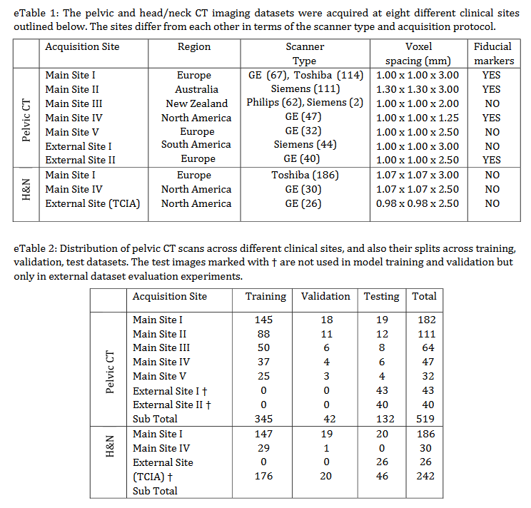
Model training description
What are you looking for in model training?

Slide 7
Model training description
How much data was used to train model?
Where did it come from and is it representative of your patient cohort
Cross-validation / hold-out data

Slide 8
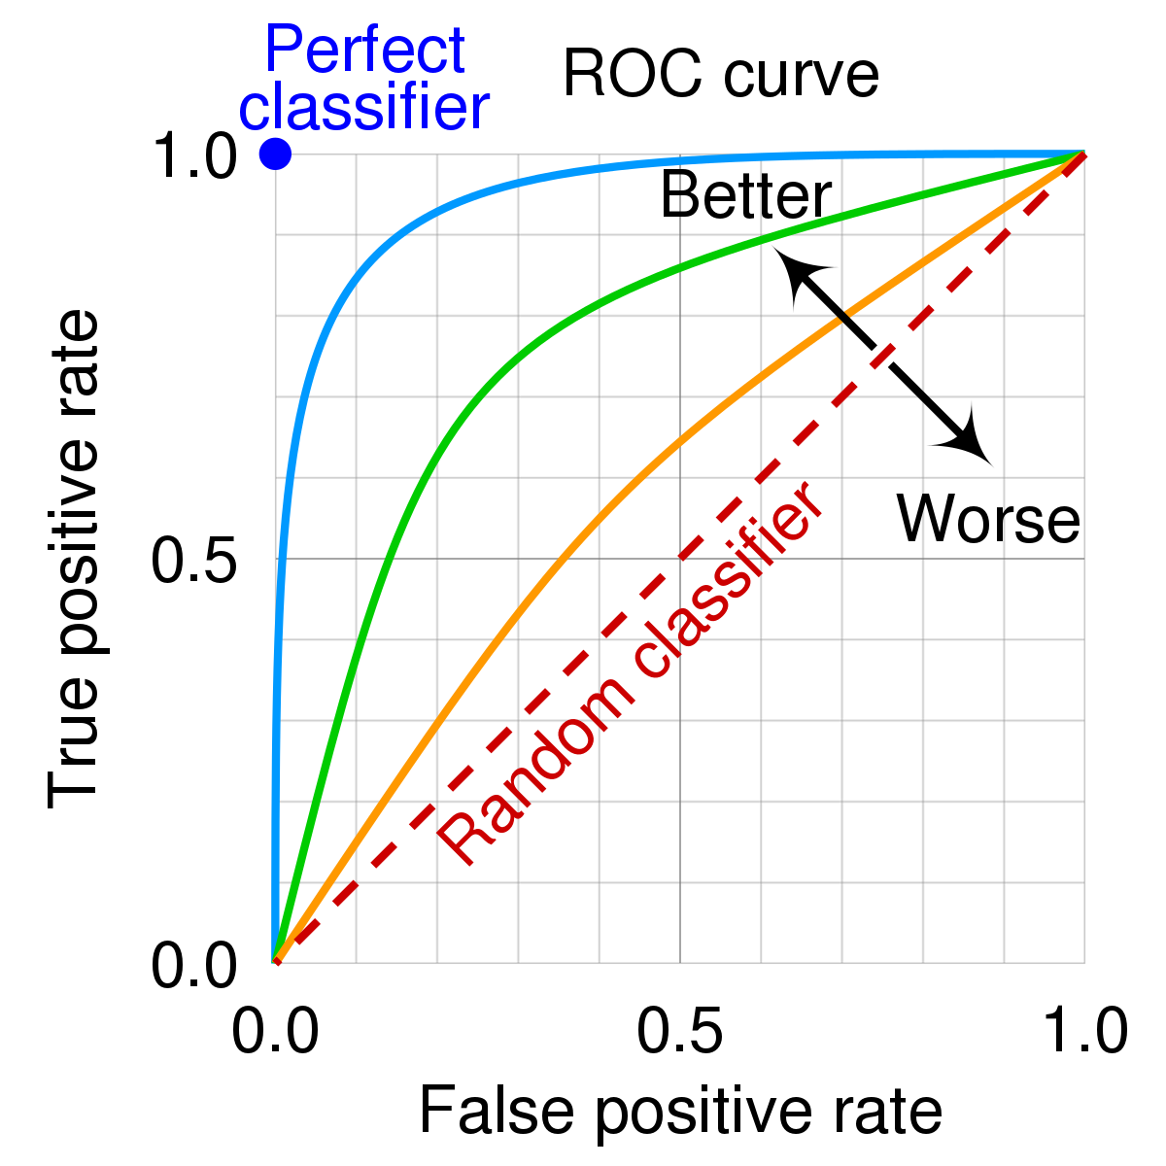
Assessing AI performance
AUROC curve
Q – how is this helpful?
ROC Curve and AUC: Evaluating Model Performance | by İlyurek Kılıç | Medium

Slide 9
Assessing AI performance
AUROC curve
Good for comparing models
Broad picture of utility
Beefburger test ☺
ROC Curve and AUC: Evaluating Model Performance | by İlyurek Kılıç | Medium

Slide 10
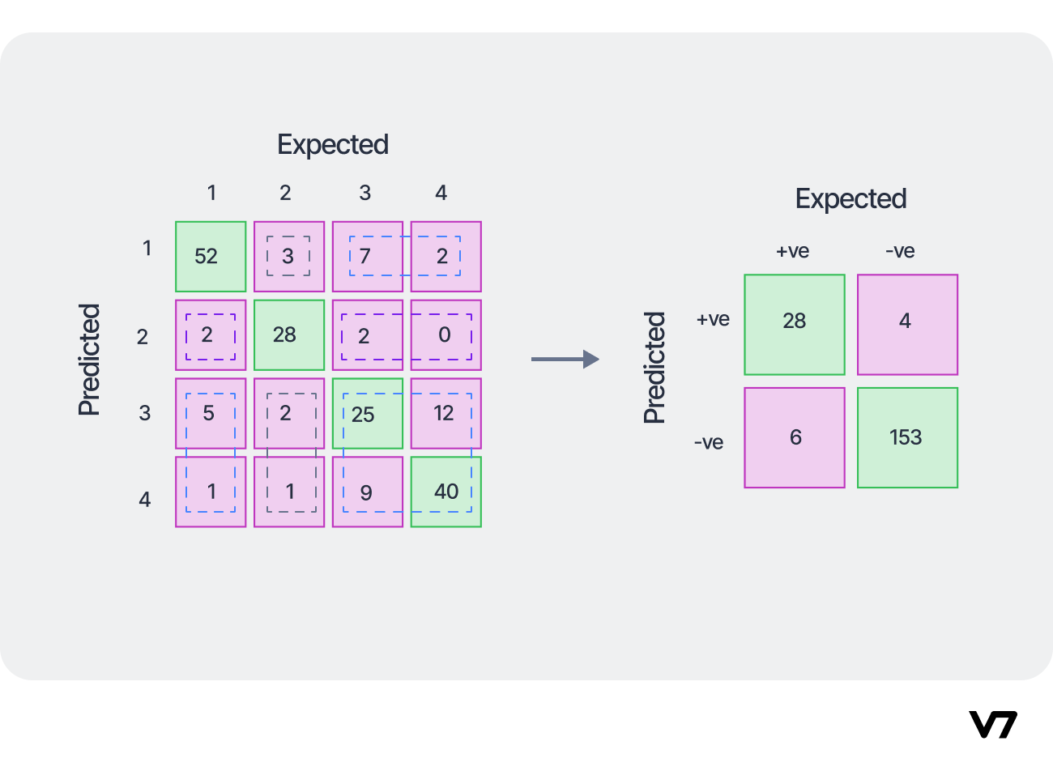
Assessing AI performance
Confusion matrix
What can you learn from this?
Confusion Matrix: How To Use It & Interpret Results [Examples] (v7labs.com)

Slide 11
Assessing AI performance
Confusion matrix
Class performance
Regular patterns in misclassification
Specificity
Class imbalance / Event rate
Confusion Matrix: How To Use It & Interpret Results [Examples] (v7labs.com)

Slide 12
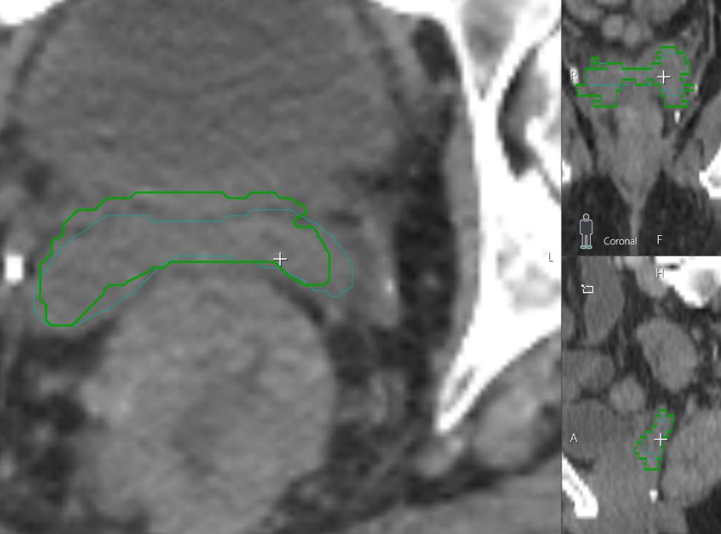
Assessing AI performance
Outlier Case review / drill down
How does this help assess risk?

Slide 13
Assessing AI performance
Outlier Case review / drill down
Edge cases
Understand poor performance in clinical context

Slide 14
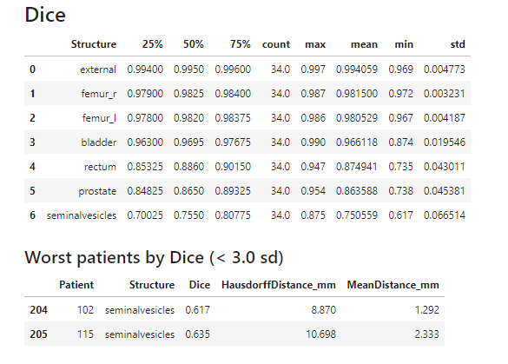
Assessing AI performance
Outlier Case review / drill down
Edge cases
Understand poor performance in context
Super-helpful if you can see training data
May not be possible for complex high-dimensional datasets

