Slide 1
Mets & Meningioma
SpR teaching Apr 24
Raj Jena

Slide 2
Overview (mets)
Should we be primary agnostic for mets?
Combined modality, PORT and LMD
Dural mets
Brainstem SRS
Radiological assessment of mets
LBMs and split course RT

Slide 3
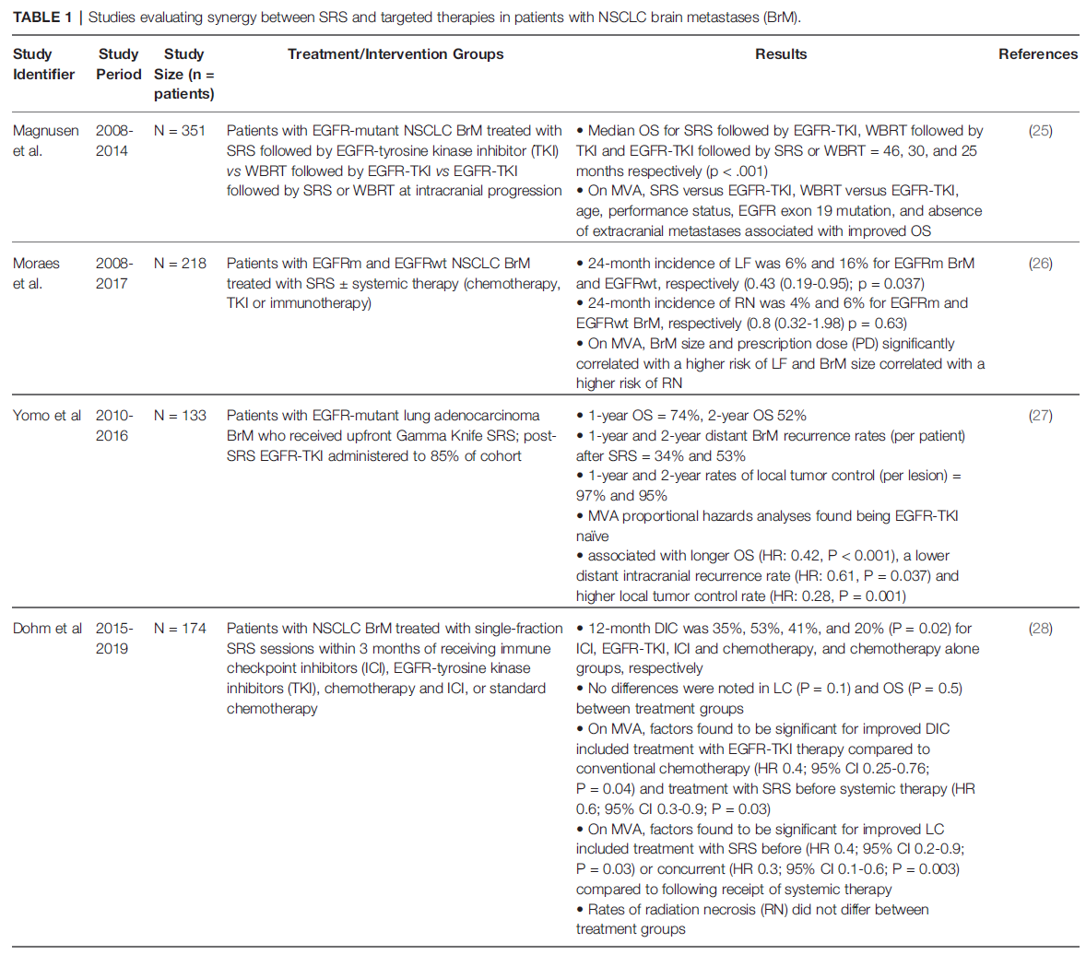
Should we be primary agnostic in SRS?
Lung
Decisions on mx made on PS, volume and multiplicity of lesions
Naive to think of OS benefit for one met and NPFS benefit for 1+ met
In era of TKI’s landscape has shifted significantly
From Rubino et al (Duke) 2022

Slide 4
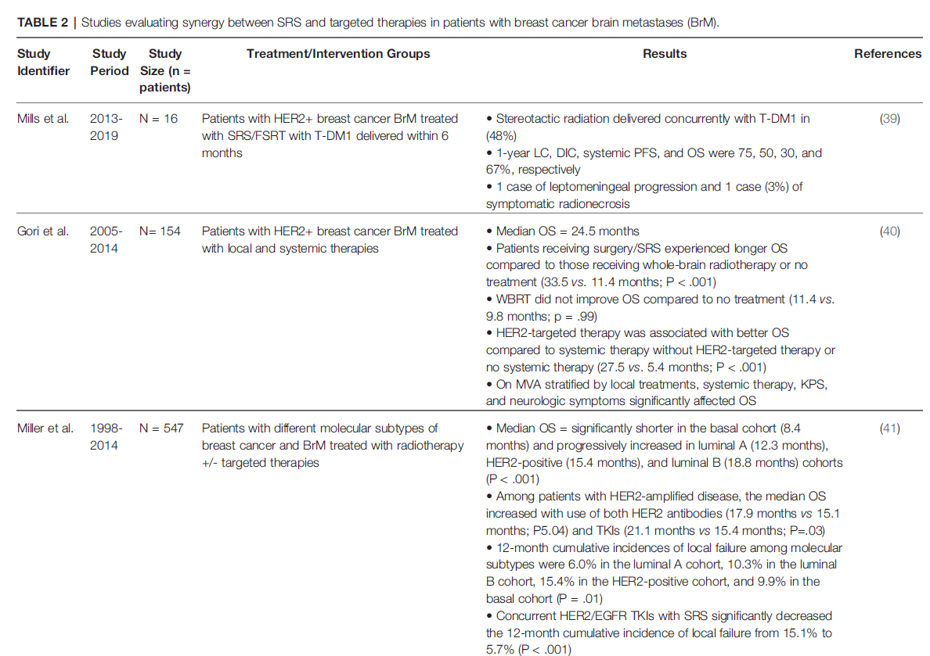
Should we be primary agnostic in SRS?
Breast
Decisions on mx made on PS, volume and multiplicity of lesions
Naive to think of OS benefit for one met and NPFS benefit for 1+ met
In era of TKI’s landscape has shifted significantly
From Rubino et al (Duke) 2022

Slide 5
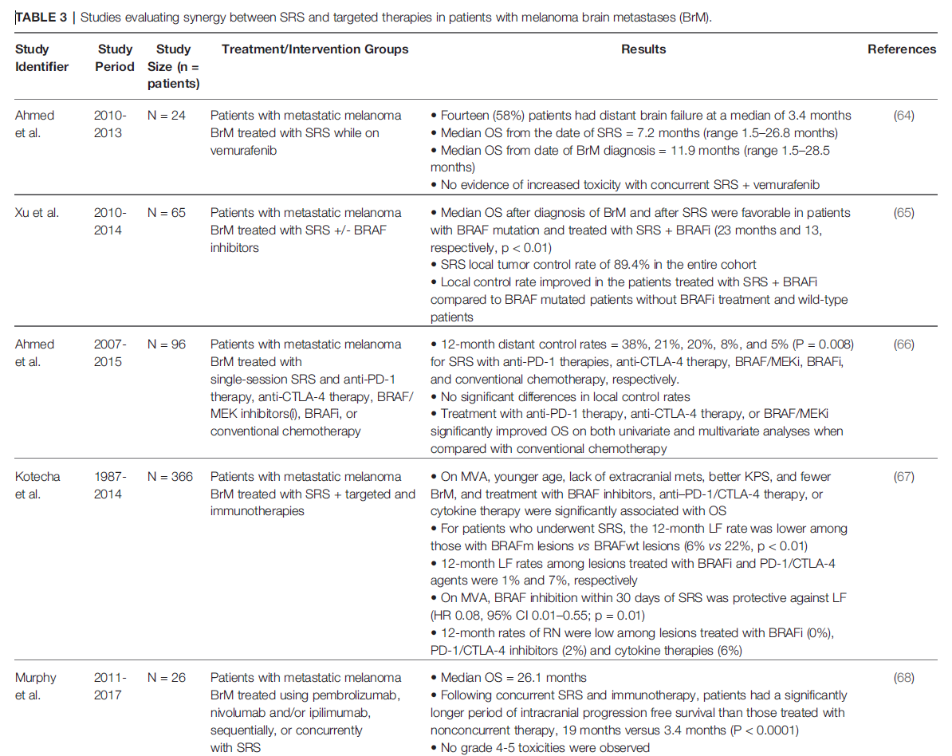
Should we be primary agnostic in SRS?
Melanoma
Decisions on mx made on PS, volume and multiplicity of lesions
Naive to think of OS benefit for one met and NPFS benefit for 1+ met
In era of TKI’s landscape has shifted significantly
From Rubino et al (Duke) 2022

Slide 6
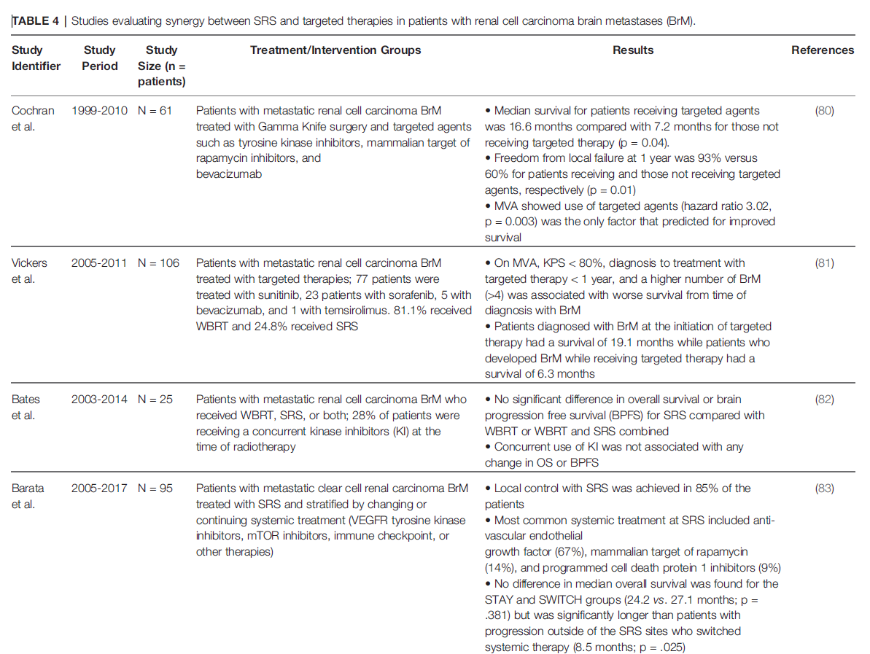
Should we be primary agnostic in SRS?
Renal
Decisions on mx made on PS, volume and multiplicity of lesions
Naive to think of OS benefit for one met and NPFS benefit for 1+ met
In era of TKI’s landscape has shifted significantly
From Rubino et al (Duke) 2022

Slide 7
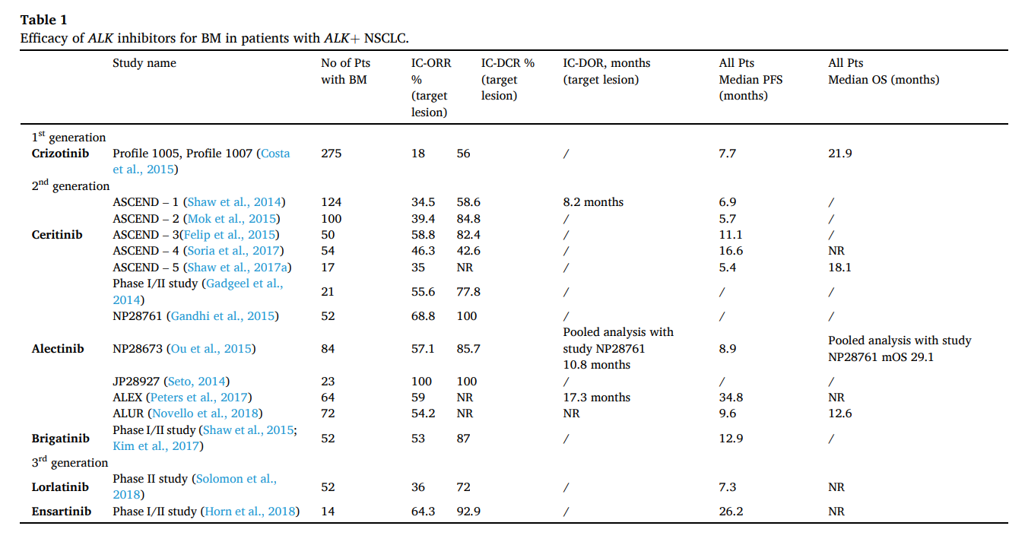
ALK hunting in lung cancer with SRS
4% of lung cancers
Common to have multiple BMs at presentation
Excellent response to combinations of TKI and SRS

Slide 8
UK NHS commissioned indications
Agnostic to primary – max volume 20cc
Controlled or controllable extracranial disease
Survival >6 months if CNS disease controlled
Known primary (histology)
KPS >70
Staging and MRI within 3m
No cranial RT in last 3 months
PO-SRS not commissioned through lack of evidence

Slide 9
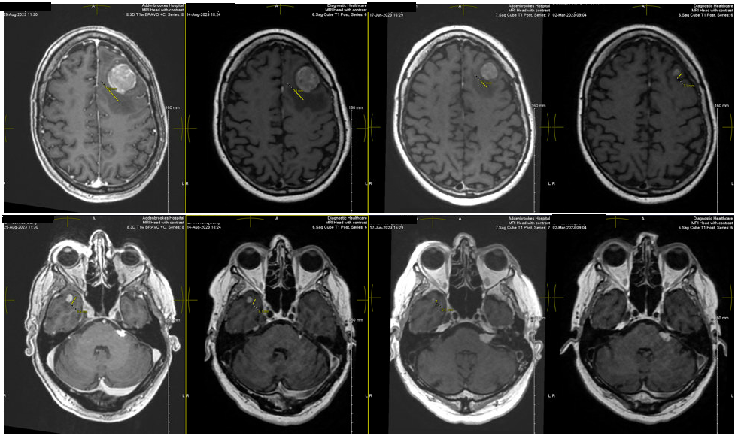
Nuanced management
Extended criteria – SRS can be used in any patient when immunotherapy is being considered
Where combined surgery and SRS are to be offered, we deliver SRS first unless target is within local volume of the disease to be resected

Slide 10
Dural mets and LMD
Guarded approach to dural mets
Breast Cancer
Lower cranial nerve palsies!!!
Only proceed if there is evidence of prior cranial imaging suggesting stable number of dural mets
1 - Illustration by Nicolas Trottier in the publication by de Rooi of 2009
2 – From https://radiologykey.com/leptomeningeal-metastasis/

Slide 11
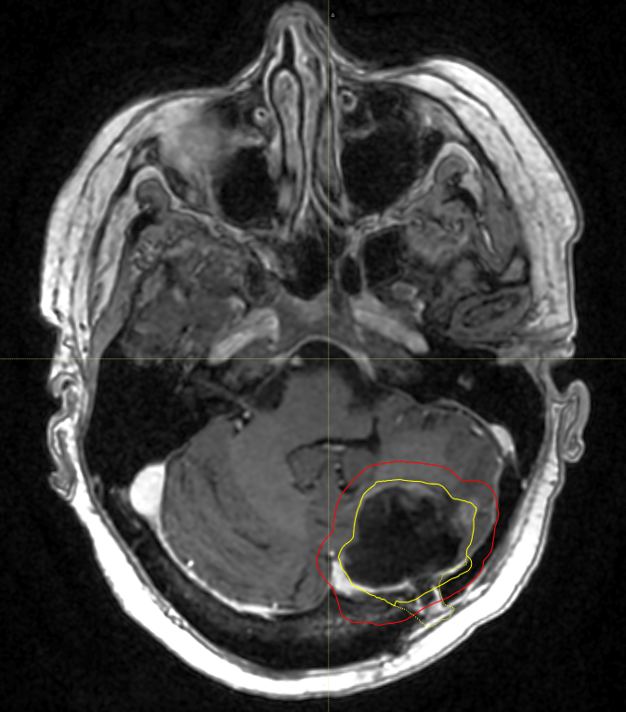
PORT
VMAT for clean cavity, SRS for any nodular recurrence
PORT very important in reducing LMD

Slide 12
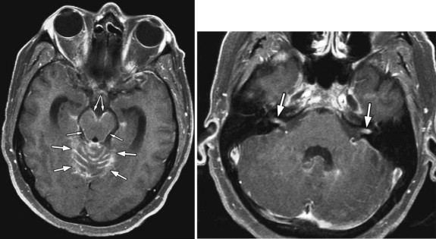
Dural metastases
Guarded approach to dural mets
Breast Cancer
Lower cranial nerve palsies!!!
Only proceed if there is evidence of prior cranial imaging suggesting stable number of dural mets
1 - Illustration by Nicolas Trottier in the publication by de Rooi of 2009
2 – From https://radiologykey.com/leptomeningeal-metastasis/

Slide 13
Our mets protocol
<1cc | Melanoma, Renal or Lung only | 24Gy 1f 80% MPI
<7cc | 21Gy 1f 80% MPI
7-12cc | 18Gy 1f 80% MPI
>12cc | 25.5Gy 3f 80% MPI
V12 (brain-gtv) <10cc for 1f, and <28cc for 3f

Slide 14
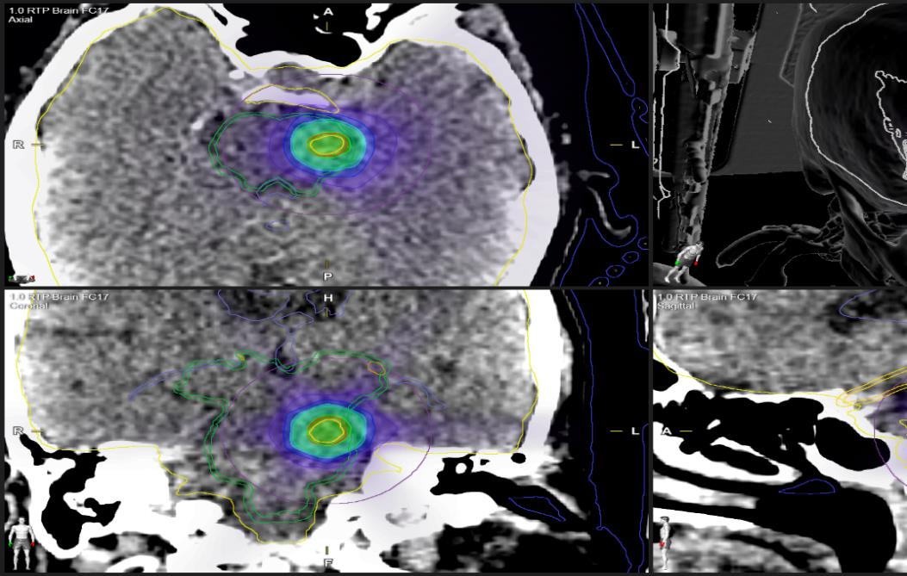
Brainstem SRS
Tend not to treat lesions >1cc
30Gy in 5f to 90% MPI over 2 weeks
Nearly gave up due to disappointing results, but recently have had two patients with good responses

Slide 15
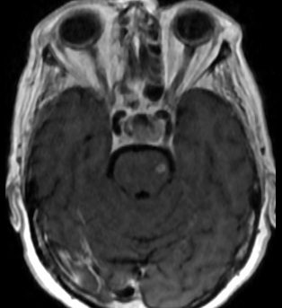
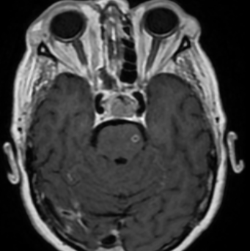
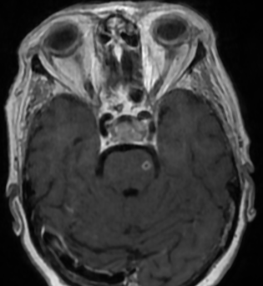
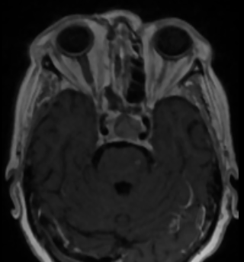
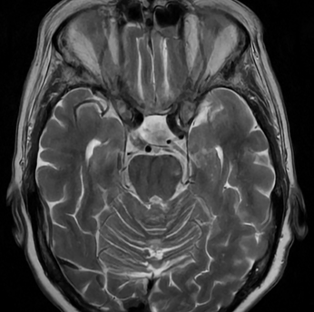
Brainstem SRS response

Slide 16
Brainstem SRS response

Slide 17
Brainstem SRS response

Slide 18
Brainstem SRS response

Slide 19
Brainstem SRS response

Slide 20
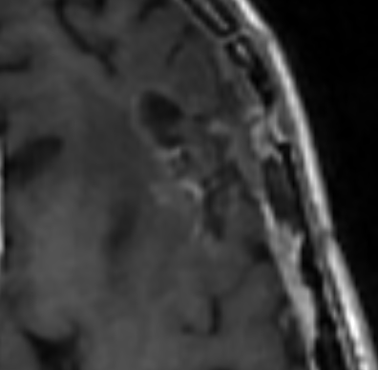
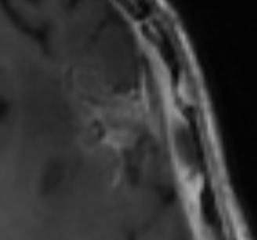
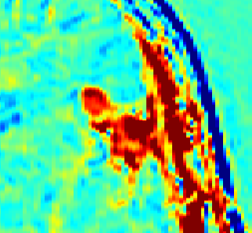
CCA for difficult response assessments
Ca Breast – isolated dural met. Post Op Cavity SRS for recurrence
GTV1 – 25.5Gy 3f 80% MPI
9 months post SRS – equivocal enhancement findings

Slide 21
CCA vs Perfusion
Perfusion plus delayed washout protocol
Radiologists prefer perfusion
CCA proves very helpful for
Unusual cases
Works in presence of haemosiderin
Works for small lesions

Slide 22
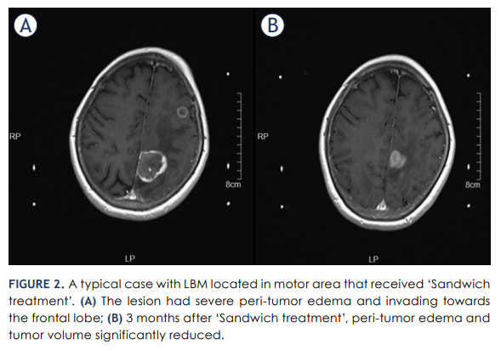
Large brain mets
Easy to fall off SACT wagon!
Surgery for mass effect
Does the met create its own surgical path?
Split dose or Sandwich SRS?
Motor strip >3cm
13gy | Bev | 12Gy 1 week later
Wang Z, Chen H, Chen Q, Zhu Y, Li M, Zhou J. Multi-institutional study of 'Sandwich treatment' for motor area large brain metastases (LBM) with diameter over 3 cm. Radiol Oncol. 2024 Jan 6;58(1):145-152. doi: 10.2478/raon-2024-0002.

Slide 23
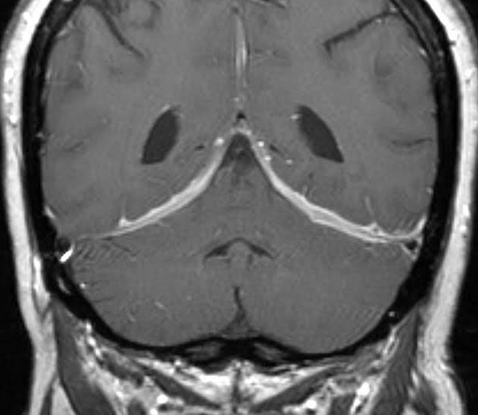
Overview (meningioma)
Simpson score
Meningioma risk score
Indications for RT or SRS
Sinus related meningioma
Pregnancy and exogenous hormones
NF2 and meningioma (Selumetinib)

Slide 24
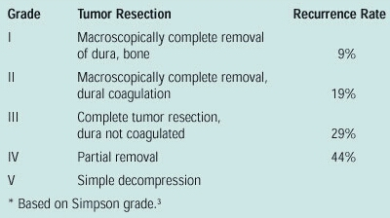
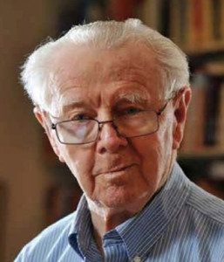
Simpson Score
Donald Simpson was a neurology trainee when he devised the score

Slide 25
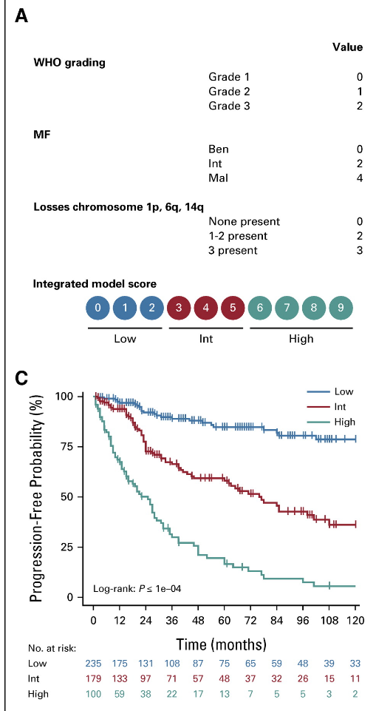
Meningioma risk score
DNA Methylation family
Copy number variation
Mutation list
TERT
CDKN2A/B
Maas et al JCO 2021

Slide 26
Indications for RT
Primary
ONSMs
Adjuvant
Any Grade 3 tumour
Grade 2+ and intermediate or high MRS
Recurrent
Grade 2+ (usually as adjuvant to resection)
Grade 1 if not resectable
“A fool with a tool is still a fool”
Brady Gooch

Slide 27
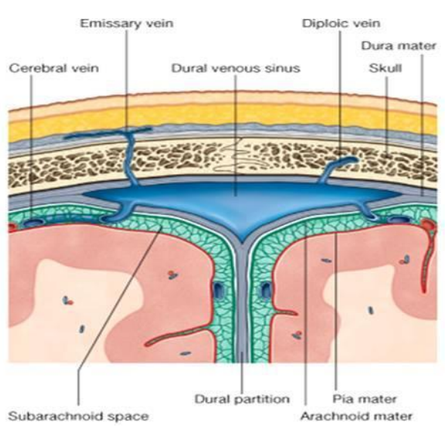
Sinus related meningioma
Sinus is nothing more than 3 dural surfaces – no muscle, no valves
Sinus meningioma can cause associated thrombosis and occlusion
If sinus is patent – impossible to get Simpson 1 or 2 resection!
Radiotherapy narrows the sinuses – venous outflow headache, ICP, papilloedema

Slide 28
Pregnancy & Meningioma
Potentially an issue for two reasons
Functioning PgR receptors
Sensitivity to cerebral blood volume
I worry much less for an irradiated tumour
2 ladies with ONSMs
1 with a recurrent convexity meningioma (pregnancy was after RT)

Slide 29
Selumetinib (AZD6244) and NF1/2
Inhibitor of MEK 1 & 2 - inhibits downstream MAP kinase pathway
Efficacy in meningioma bearing NF1 mutation
Germline (licensed for plexiform neurofibroma in TYA)
Sporadic (ask for TSO500!)
Early signs of efficacy in NF2

Slide 30
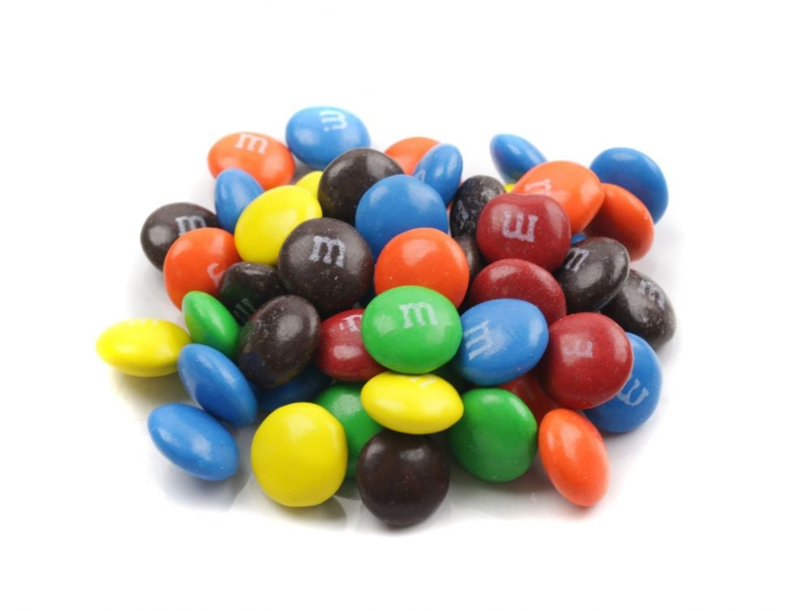
Thanks and Questions!

