Slide 1
Innovation Research and Life Sciences

Slide 3
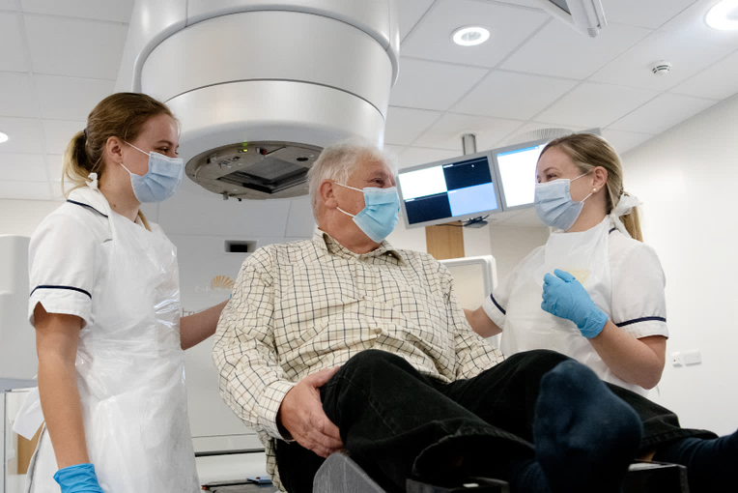
40%
Cancer patients cured with RT
4,000
Patients have RT at CUH each year
91,000
NHS Patients have curative RT each year
18%
Clical Oncology posts empty across the NHS
31 days
Target for starting RT treatment

Slide 4
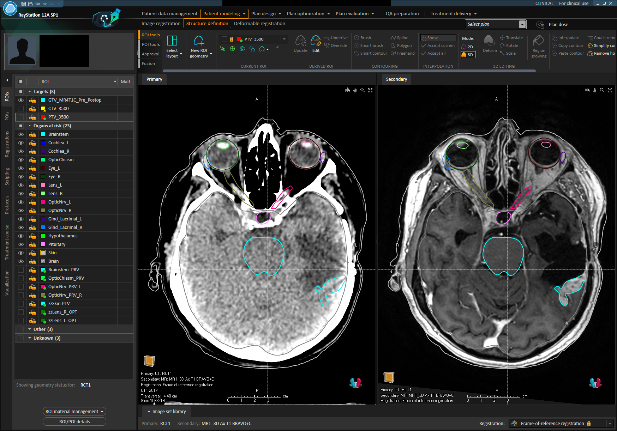

Slide 5
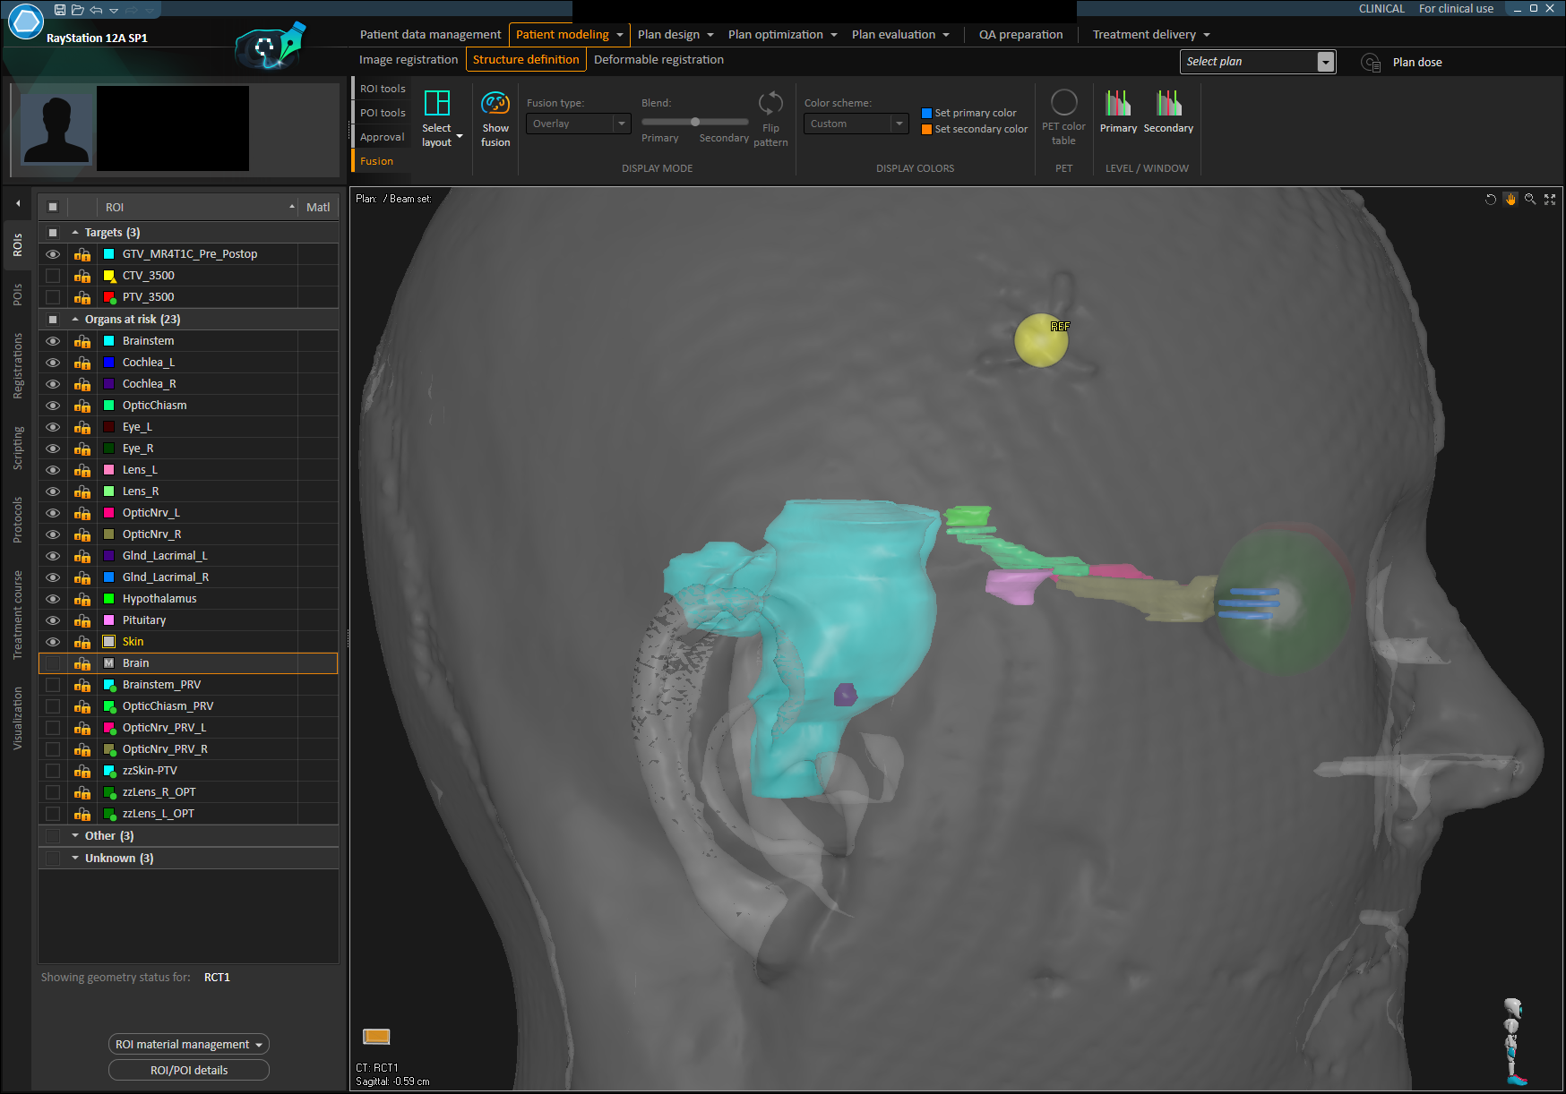

Slide 7
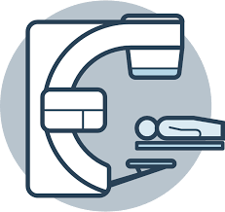
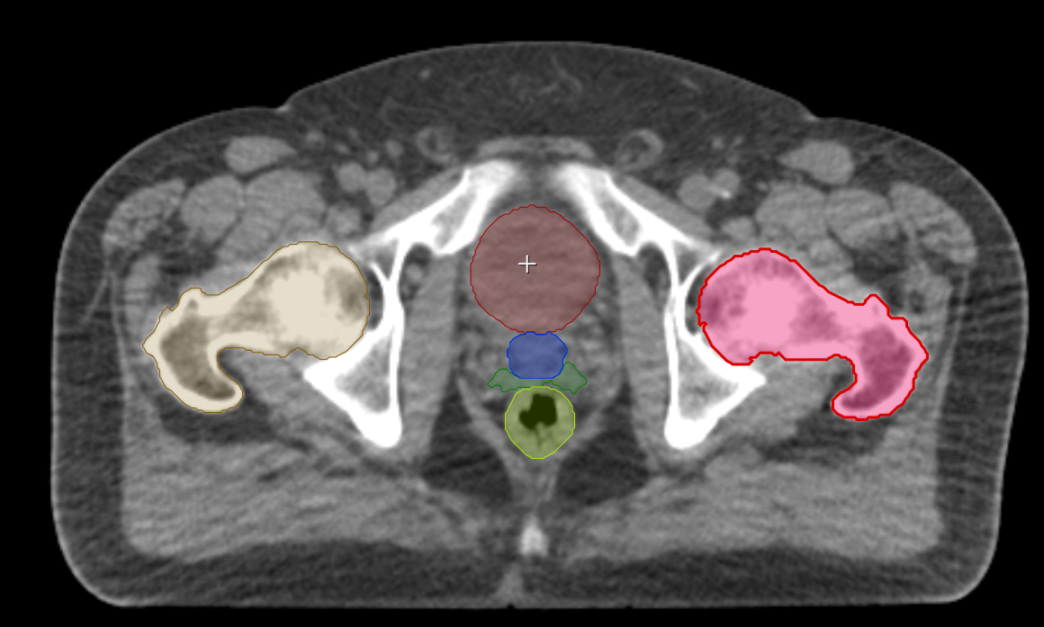
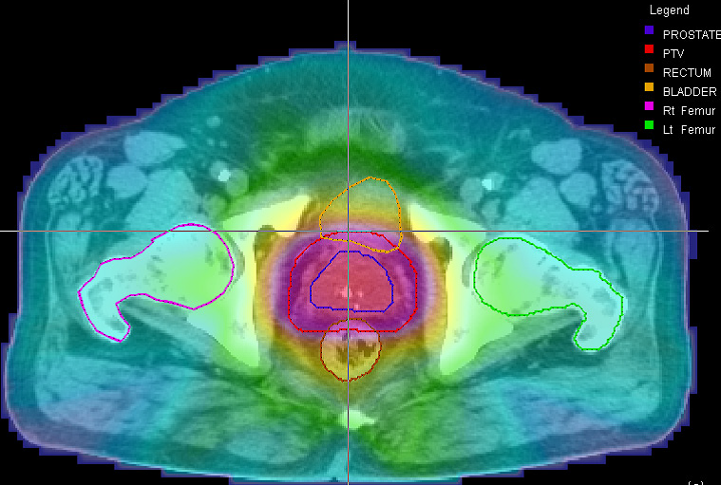
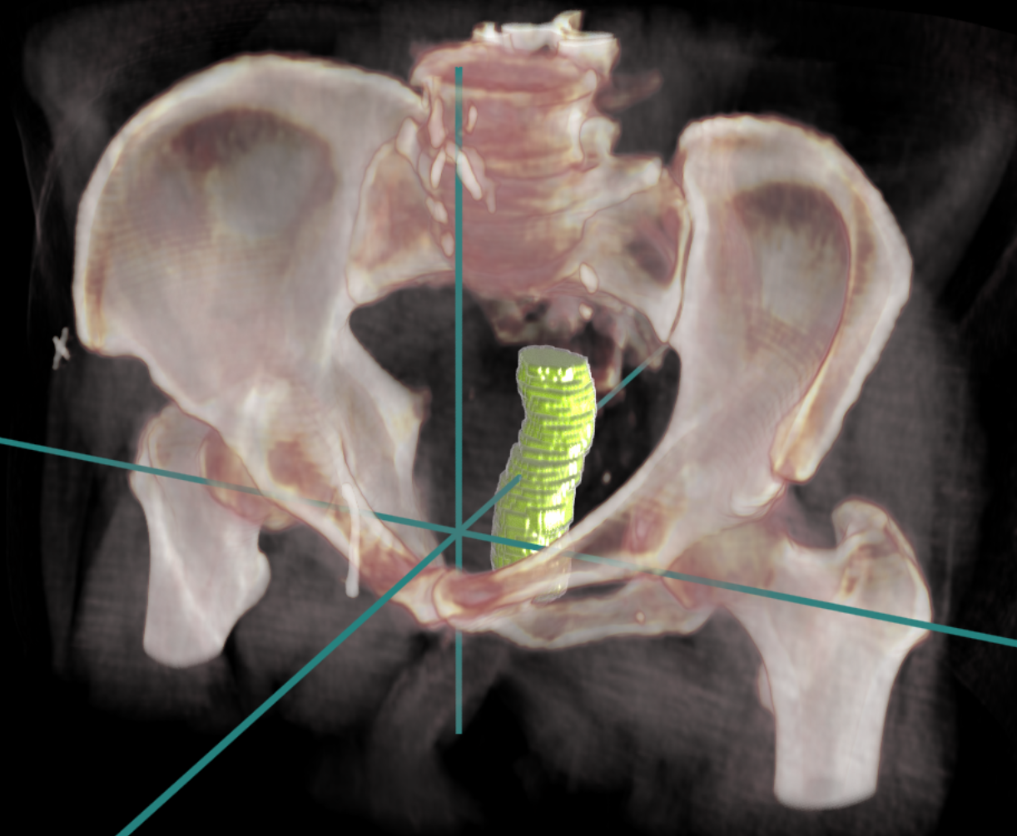
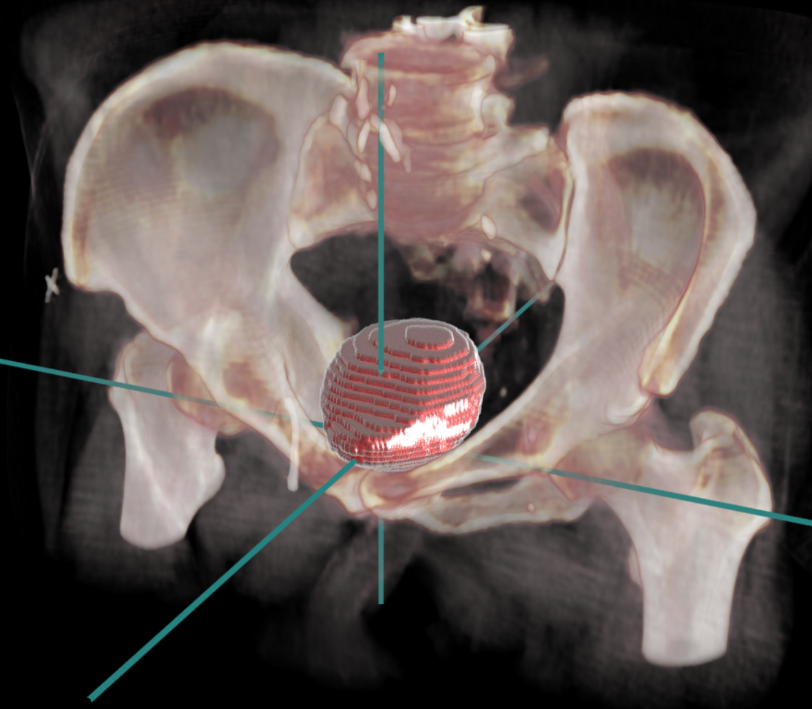
Clinical imaging pathway
Imaging
3D Segmentation
Treatment planning
Treatment delivery
Sim-CT 1
Sim-CT 2
Cloud based AI Pathway
Gateway Device
Cloud-enabled Machine Learning Models
Training pipeline
Inference Pipeline

Slide 8
2017
2023
Assess
See patient in clinic
Assess
See patient in clinic
Plan
Prepare, and check precision RT – 31 days
Plan
Prepare, and check precision RT – 15 days
Treat
20-30 daily treatments over 4-6 weeks
Treat
3-5 daily treatments over 1-2 weeks

Slide 9
The AI Factory Concept

Slide 10
Exchange model configuration file with other hospital (data derivatives only)
Collect patient datasets
Curate data labels
(Re)train ML models
+
Develop new models
Evaluate performance & commission model
Deploy model for patient benefit
OSAIRIS Deep Learning + AzureML

Slide 11
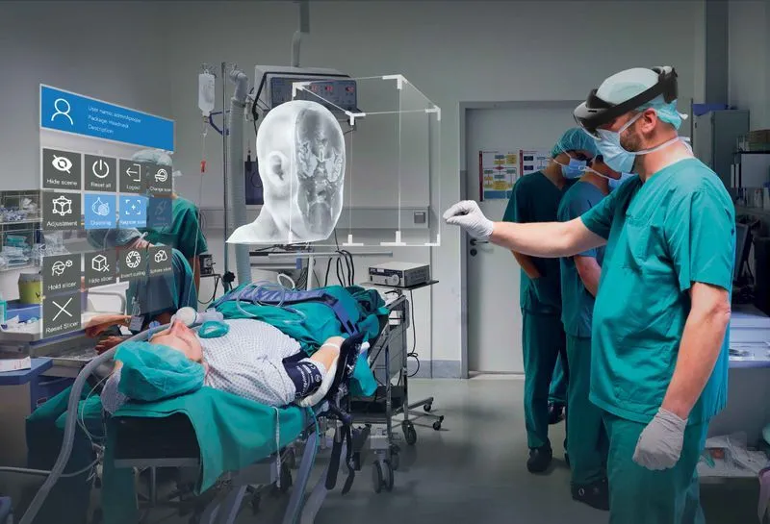

Slide 12
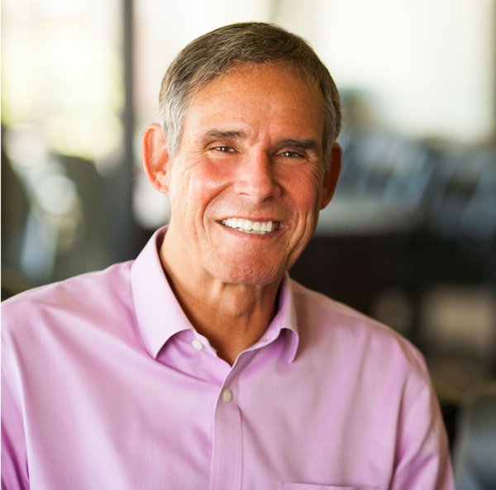
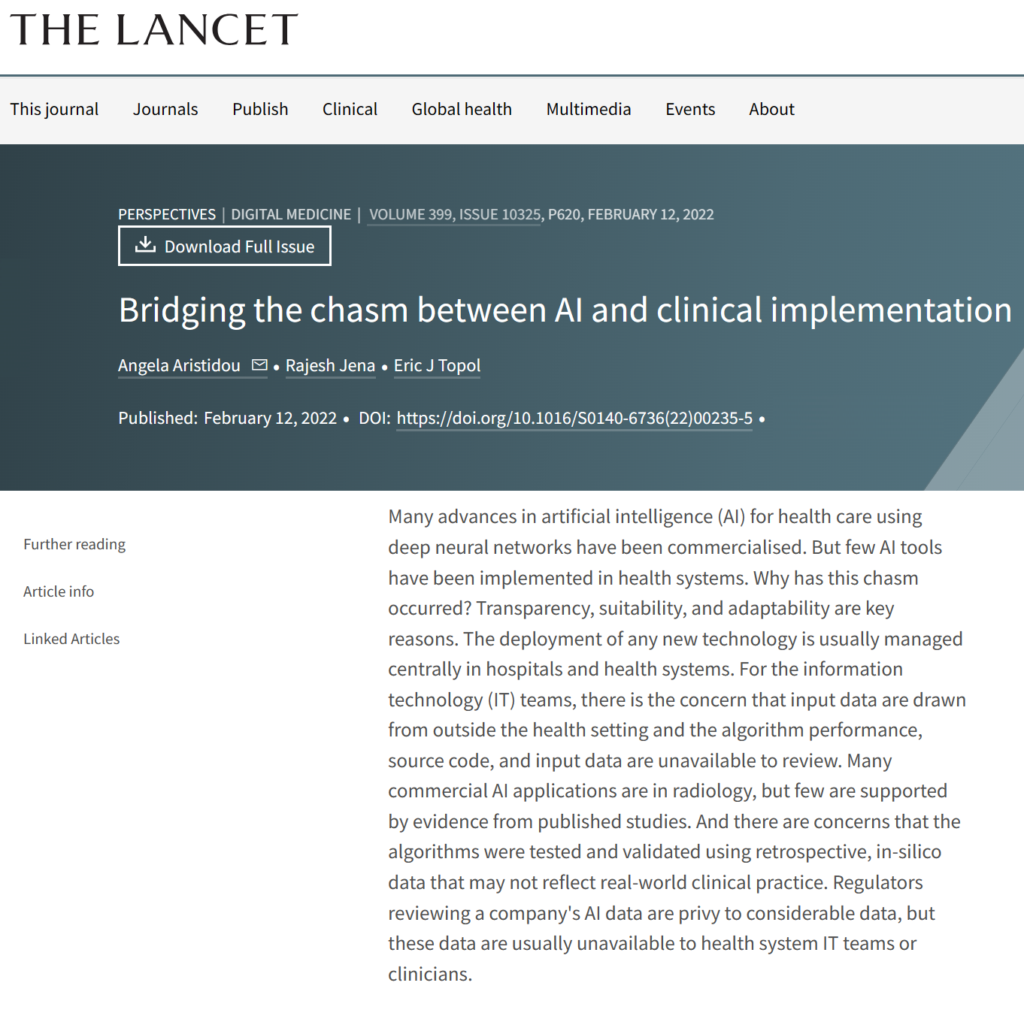
“AI should give clinicians the gift of time”
Eric Topol

