Slide 1
Medical Student Training in Oncology
Lecture 1
Key competencies in cancer care

Slide 2
Learning objectives
The Cancer Pathway & Cancer Journey
Red flag symptoms, differential diagnosis
Staging
Co-factors for decision making, treatment intent
Planning and prognosticating
Treatment initiation
Considerations for cancer screening
Lecture 1 | Key Competencies

Slide 3
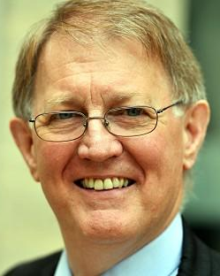
Cancer pathways
Before the NHS Cancer plan
Primary care doctors had to work out which doctor they should contact to see a patient with suspected cancer
Cancer was often managed by surgeons, who made decisions on referral for ongoing treatment
The NHS Cancer plans set targets for patient referral and treatment times, and mandated standardised pathways for patient care.
Multidisciplinary team meeting meet regularly, offer electronic referral proformas and employ coordinators to ensure all patients are discussed and relevant plans are put into place.
Mike Richards
Erstwhile Cancer Tsar
Lecture 1 | Key Competencies

Slide 4
Cancer pathways
How quickly should a patient with suspected cancer be seen by a specialist?
How quickly should a patient start treatment having been seen by an appropriate specialist, once a diagnosis of cancer has been established?
Lecture 1 | Key Competencies

Slide 5
Cancer pathways
How quickly should a patient with suspected cancer be seen by a specialist?
Within 2 weeks
How quickly should a patient start treatment having been seen by an appropriate specialist, once a diagnosis of cancer has been established?
Within 28 days
Lecture 1 | Key Competencies

Slide 6
Cancer Journey
Consider from a patient’s point of view
Treat
Diagnose
Stage
Co-factor
Refer
Plan
Prognosticate
Explain
Treat
Lecture 1 | Key Competencies

Slide 7
Treat immediate symptoms
Sounds obvious but in the rush of trying to diagnose a suspected cancer, the symptoms of the patient may be overlooked
These need to be considered and treated in a holistic fashion
What are the commonest immediate symptoms?
Lecture 1 | Key Competencies

Slide 8
Treat immediate symptoms
Sounds obvious but in the rush of trying to diagnose a suspected cancer, the symptoms of the patient may be overlooked
These need to be considered and treated in a holistic fashion
What are the commonest immediate symptoms?
Acute Pain
Headache
Breathlessness
Bleeding
Visceral obstruction
Lecture 1 | Key Competencies

Slide 9
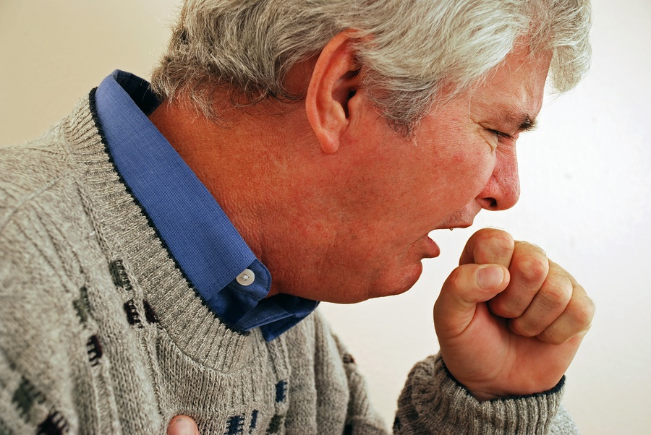
Establish a (cancer) diagnosis
Cancer must enter your differential diagnosis when you see the patient
Think about ‘Red Flag’ symptoms:
Each red flag has a PPV >25% for a cancer diagnosis
Undertake appropriate imaging or diagnostic investigations
Lecture 1 | Key Competencies

Slide 10
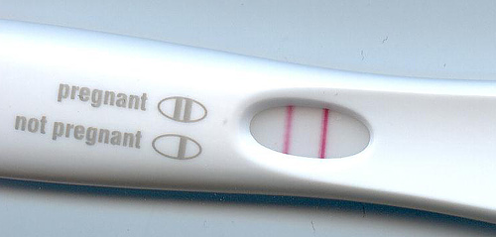
Confirm diagnosis
Confirmation of diagnosis is usually within the remit of a specialist MDT, but there are some exceptions
Bronchoscopy / endoscopic biopsies
Punch biopsies for skin lesions
Blood film / bone marrow aspirate
Tumour markers
Radiological diagnosis where biopsy is not safe / possible
What is the cancer diagnosis?
Lecture 1 | Key Competencies

Slide 11
Staging
Staging involves performing necessary investigations (usually imaging) to assess extent of disease spread
UICC TNM staging system used for many cancers
T = tumour stage
N = nodal stage
M = metastatic disease spread
TNM stages often then merged into clinical stages (1-4)
Useful as a common dialogue (e.g. T3 N2 M0 lung cancer)
Essential for guiding management and establishing treatment intent
Useful for prognosis
Consider that staging may be revised radiological, pre-operative, post-operative
The TNM Atlas. A common dialogue for cancer specialists across the world
Lecture 1 | Key Competencies

Slide 12
Treatment intent
Very important to establish the intent of treatment after diagnosis and staging is complete
Curative intent
Benign conditions (meningioma)
Localised disease
Metastatic disease in very sensitive tumours (Lymphoma, Germ cell tumour)
Accept significant acute toxicity if cure is possible
Consider long term effects of therapy
Support patient through side effects, even if this requires ITU admission
Palliative intent
Metastatic disease (solid tumours)
Locally advanced disease
Patient co-factors preclude radical treatment
May still need intensive therapy to achieve palliation (e.g. Head & Neck Cancer)
Balance side effects of treatment with QOL
Ceiling of supportive care
Lecture 1 | Key Competencies

Slide 13
Treatment scenarios
Radical and palliative have been discussed
Primary treatment : using Chemo or RT in place of surgery (e.g. RT for Head & Neck Cancer)
Neo-adjuvant : using Chemo or RT to shrink (downstage) a tumour prior to definitive surgery (e.g. Colorectal cancer)
Adjuvant : using Chemo or RT after surgery to improve loco-regional control and survival (e.g. Breast cancer)
Concomitant : Using chemotherapy in combination with radiotherapy (e.g. Glioblastoma)
Lecture 1 | Key Competencies

Slide 14
Co-factors and Performance Status
Cannot consider tumour factors in isolation from patient factors
Oncologists like to know performance status of patient (we use mainly WHO PS)
PS is usually the most important prognostic factor after disease stage
WHO PS works well but focuses on mobility rather than global function
Co-factors are important in establishing suitability for treatment
Consider Physical, Cognitive, and Social co-factors
WHO PS | Explanation of activity
0 | Fully active, able to carry on all pre-disease performance without restriction
1 | Restricted in physically strenuous activity but ambulatory and able to carry out work of a light or sedentary nature, e.g., light house work, office work
2 | Ambulatory and capable of all selfcare but unable to carry out any work activities. Up and about more than 50% of waking hours
3 | Capable of only limited selfcare, confined to bed or chair more than 50% of waking hours
4 | Completely disabled. Cannot carry on any selfcare. Totally confined to bed or chair
5 | Dead
Lecture 1 | Key Competencies

Slide 15
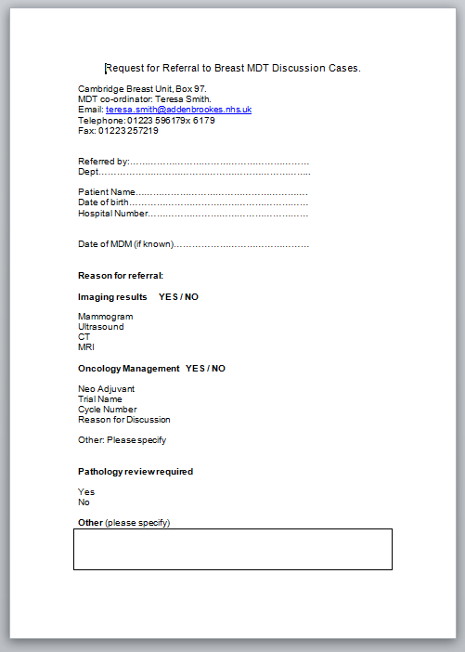
Making the referral
An important process. Your referral starts the clock for cancer waits. Incomplete referrals introduce delays for definitive treatment
Find out which MDT to refer to (not always easy. Does a patient with meningeal metastases go to the CNS MDT or the skull base MDT)?
Every MDT has a coordinator. Contacting them for advice is often a good idea
Some MDTs move to electronic referral systems. They will often not let you progress the referral until you place an answer in every box. Whilst this is frustrating it prevents incomplete referrals and ultimately results in better service for your patient.
Lecture 1 | Key Competencies

Slide 16
Prognosticating and weighing up treatment options
Prognosis relates both to patient factors and treatment factors
Need to evaluate treatment options before discussing them with the patient
Consider level of evidence
Consider level of efficacy
Recommendations made by NICE are strongly influenced by evidence level
Randomised controlled trials are considered the best form of evidence, but technically an RCT should only be used to evaluate two treatments considered on the basis of available evidence to be iso-effective
Lecture 1 | Key Competencies

Slide 17
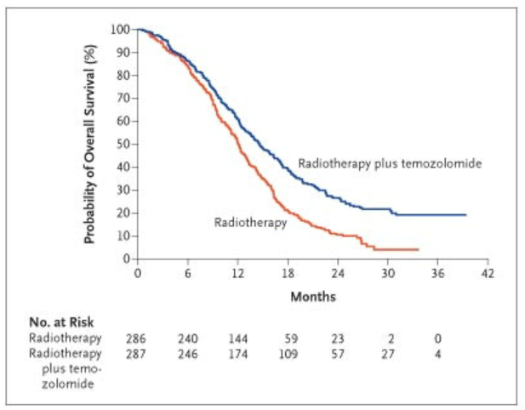
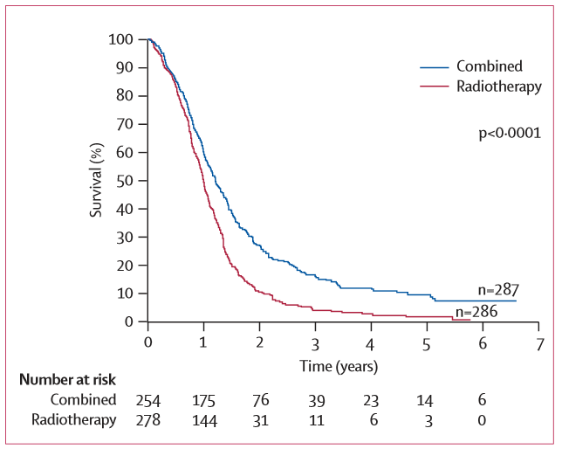
Assessing efficacy
K-M curves initially reported for a landmark study of chemoradiation in 2005. Look at the magnitude of survival benefit at 36 months. (Stupp NEJM 2009)
Most interventions will report overall survival as primary endpoint
Usual analysis is a Kaplan-Meier survival curve
Useful to understand how these work as they give a lot of data
Survival rates at different periods of time after an intervention
Deal with censored data (survival time is not known at the time the study ends)
Maximise use of follow-up data
K-M curves for 5 year follow-up. The survival benefit is not maintained (Stupp NEJM 2009)
Lecture 1 | Key Competencies

Slide 18
What do these K-M curves indicate?
Blue line = investigation arm | Red line = control arm
Lecture 1 | Key Competencies

Slide 19
What do these K-M curves indicate?
Blue line = investigation arm | Red line = control arm
Treatment delays progression, doesn’t improve survival
Treatment enhances survival
Treatment is toxic. Some patients die but survival overall is enhanced
Lecture 1 | Key Competencies

Slide 20
Meta-analysis
Individual RCTs are prone to bias and effects of the study protocol
Meta-analyses analyse effects of multiple RCTs. This should be done by going back to individual patient data from each RCT and producing summary statistics (though often this is not the case)
What is an odds ratio?
What is a hazard ratio?
Lecture 1 | Key Competencies

Slide 21
Meta-analysis
Individual RCTs are prone to bias and effects of the study protocol
Meta-analyses analyse effects of multiple RCTs. This should be done by going back to individual patient data from each RCT and producing summary statistics (though often this is not the case)
What is an odds ratio?
Relative risk of an event in each arm of the study, independent of time. Calculated by looking at the total number of events in a trial (e.g. odds ratio of vomiting). Not good for survival.
What is a hazard ratio?
Takes into account time. Hazard = rate at which events happen. Hazard in one arm of a study is a constant proportion of the hazard in the other arm of a study. This is the hazard ratio.
Lecture 1 | Key Competencies

Slide 22
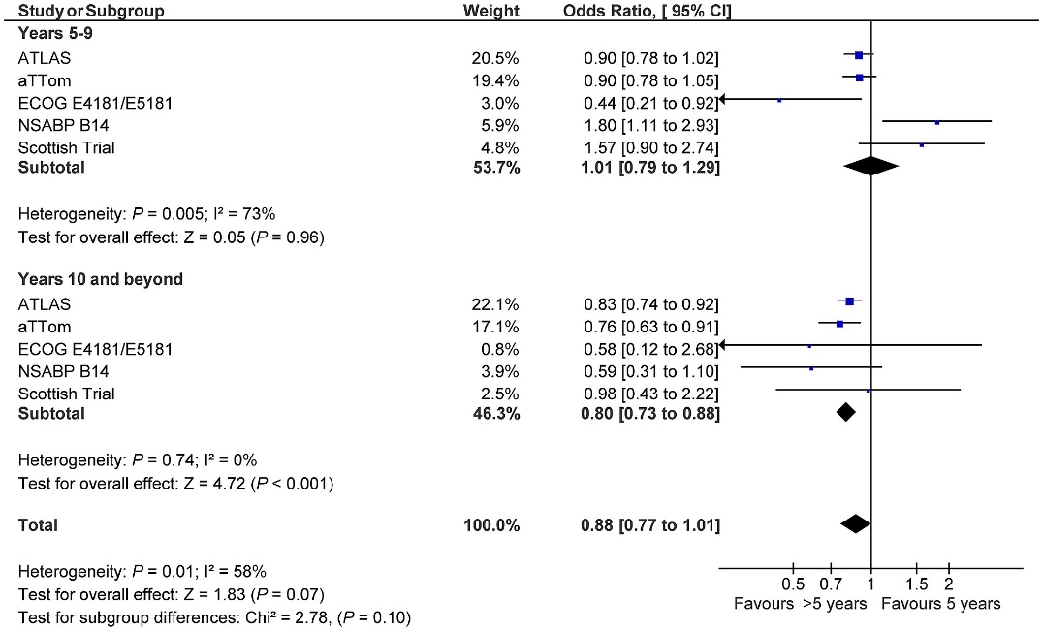
Meta-analysis
Confidence interval + hazard ratio often expressed in a Forrest (box-whisker) plot
Look at this plot – would you recommend extended adjuvant tamoxifen on the basis of this data?
Lecture 1 | Key Competencies

Slide 23
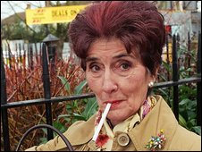
Communicating data to patient
Best example of balancing up the Scholar and the Physician in a Doctor
Even in a common indication with evidence from meta-analyses, there is no right answer
Need to include patient factors in prognostication
Consider patient’s information needs
The ‘Internet patient’ : Comes to clinic with reams of paper or an Ipad. Wants to know all of the details leading to the decision making process.
The ‘accepting patient’ : Comes to clinic with the expectation that the doctor knows best and will decide on the best course of treatment.
Try and observe how complex data is discussed with patients in our clinics
Lecture 1 | Key Competencies

Slide 24
A word on screening
Happens upstream from us in Oncology, but it is very important for us to understand
Can you name the Wilson criteria for a screening programme?
Condition should present a significant health problem to the population
Natural history of the disease must be understood
Early and late stages of disease must be recognisable
Available screening test that is sensitive and specific
An accepted policy should be available for who needs treatment
Accepted treatment options for the disease should be available
Treatment in early stage must impact on survival
Screening should be cost effective
Key concept to remember is that screening detects occult malignancy in patients that are well. Prognosis will be better than patients presenting with symptoms.
Lecture 1 | Key Competencies

Slide 25
Summary
In the department we have 40+ oncologists dealing with range of cancers
All will use these key competencies, and follow this approach to a cancer patient
Understanding this will allow you to help your patients with suspected cancer to obtain rapid and appropriate treatment
Balance of the scholar and the physician is needed to get the process right
During your attachment do try to attend at least one consultation where initial treatment options are discussed with the patient, and follow this process through.
Lecture 1 | Key Competencies

