Slide 1
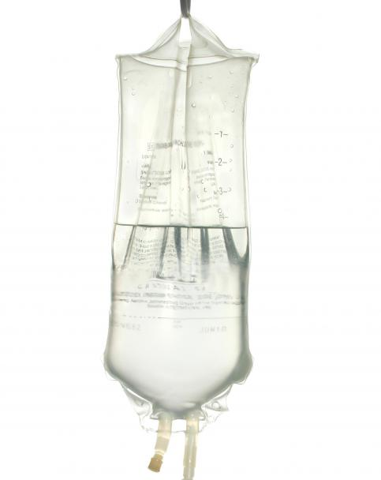
Medical Student Training in Oncology
Lecture 3
Introduction to chemotherapy
Biological therapies

Slide 2
Learning objectives 1
Understand the evolution of systemic anti- cancer therapies
Review mechanisms of action of chemotherapy agents
Understand principles of chemo scheduling and combination therapy
Consider chemo toxicity and mechanisms for chemotherapy resistance
Lecture 3 | Intro to Chemo & Biologicals

Slide 3
Learning objectives 2
Review druggable targets for biological therapies
Appreciate differences between monoclonal antibodies and small molecule inhibitors
Distinguish cytocidal and cytostatic therapies
Review common side effects of these therapies
Lecture 3 | Intro to Chemo & Biologicals

Slide 4
Generations of chemotherapy
1950’s
Nitrogen mustards
Antifolates
Purine analogues
Cytotoxic antibiotics
1970’s
Anthracyclines
Organoplatinum compounds
1990’s
Taxanes
Camptothecins
Gemcitebine
Lecture 3 | Intro to Chemo & Biologicals

Slide 5
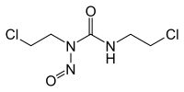
Nitrogen mustards
Sulphur Mustard
Derived from Mustard gas
Nitrogen mustards are potent DNA alkylators
Achieved incredible responses in patients with lymphoma, who had relapsed after surgery and radiation therapy
Carmustine
Lecture 3 | Intro to Chemo & Biologicals

Slide 6
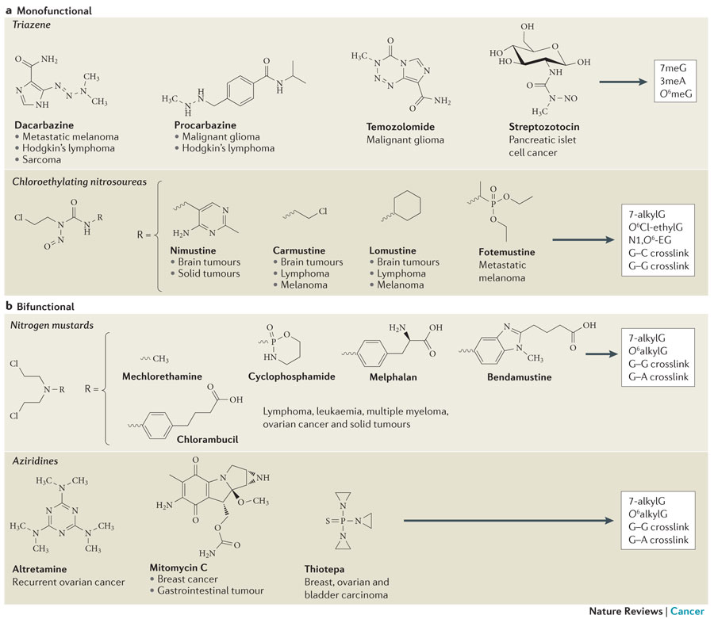
Alkylating agents
Modifcation of purine bases in DNA
Guanine alkylation
Adenine alkylation
Chemical cross-linking of bases
Leads to defective DNA repair or replication
Lecture 3 | Intro to Chemo & Biologicals

Slide 7
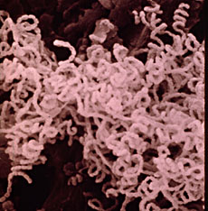
Antifolates & Purine analogues
Drugs all work as antimetabolites or inhibitors of enzymes on purine biosynthesis pathway. Methotrexate is main agent still in use.
Which cells might be most affected in patients?
How can side effects of antifolates be reduced?
Streptomyces growing in soil – the source of Actinomycin D
Lecture 3 | Intro to Chemo & Biologicals

Slide 8
Antifolates & Purine analogues
Drugs all work as antimetabolites or inhibitors of enzymes on purine biosynthesis pathway. Methotrexate is main agent still in use.
Which cells might be most affected in patients?
Rapid dividing cells – tumour(!), mucosal surfaces (mucositis), Bone marrow (neutropaenia)
How can side effects of methotrexate be reduced?
Use folinic acid to restore folate levels
Streptomyces growing in soil – the source of Actinomycin D
Lecture 3 | Intro to Chemo & Biologicals

Slide 9
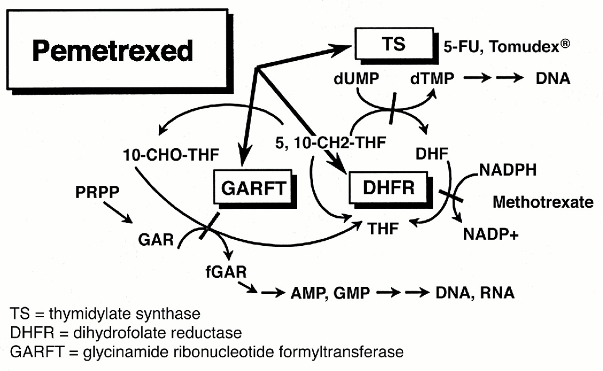
Antifolate mechanisms
3 main pathways targeted by antifolate drugs
Dihydrofolate reductase
Aminopterin
Methotrexate
PRPP/GARFT pathway
6-Mercaptopurine
Thymidylate synthetase
5FU, Capecitebine
Or all 3 at the same time
Pemetrexed
Lecture 3 | Intro to Chemo & Biologicals

Slide 10
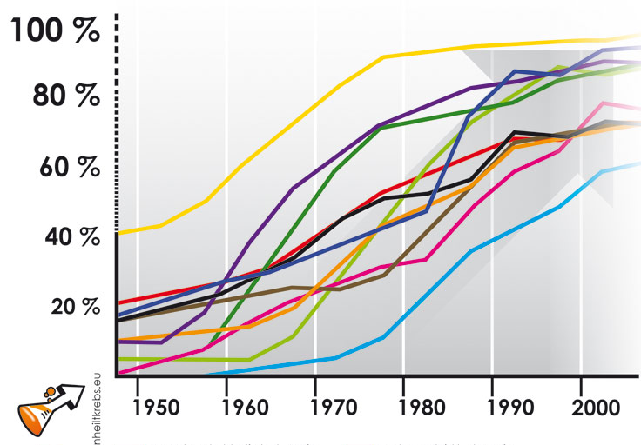
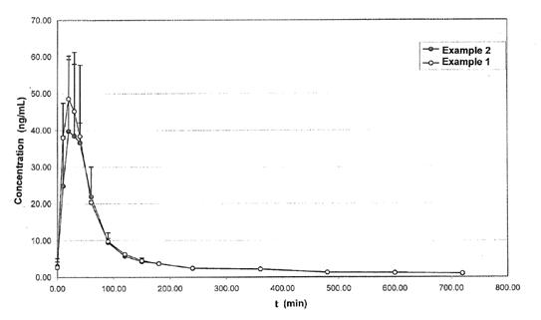
Platinum agents
1965 : Cisplatin first discovered by accident by Barnett Rosenberg
Eventually developed organic platinum compounds for human use in 1972
By 1978 Cisplatin had transformed outlook for testicular cancer
Carboplatin – 2nd generation platinum agent
Interesting pharmacokinetics. 100% renally cleared, no active metabolites, no hepatic metabolism
Dosed according to a multiple of the area under creatinine clearance curve
Lecture 3 | Intro to Chemo & Biologicals

Slide 11
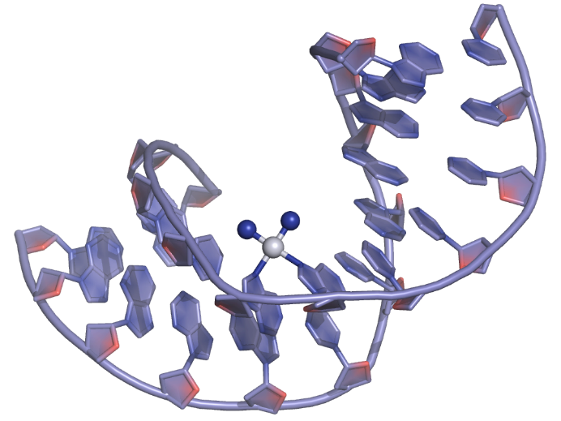
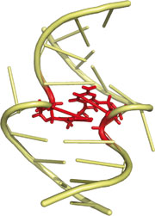
Platinum mechanisms of action
Intrastrand DNA cross-links
Interstrand DNA cross links
DNA-histone crosslinks
Induce apoptosis
Intrastrand cross-link
Interstrand cross-link
Lecture 3 | Intro to Chemo & Biologicals

Slide 12
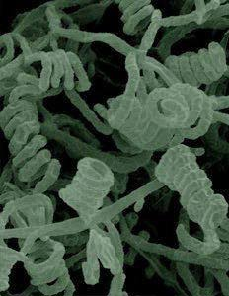
Anthracyclines
Isolated from fungus
Late 1960’s clinical trials showed potent effects in leukaemia and lymphoma
Works through intercalation of molecule into DNA, which prevents action of Topoisomerase I. Also induces free radicals.
Problem of dose dependent cardiac toxicity, leading to deaths from heart failure on first use
Lifetime dose of anthacyclines has to be calculated for every patient
Lecture 3 | Intro to Chemo & Biologicals

Slide 13
Combination chemotherapy
Acronym central!
Chemotherapy agents used in combinations
Synergistic effects compared to single agent therapies
Try to overcome response heterogeneity and overcome resistance in tumours
Lower dose of each drug = lower risk of toxicity
Many regimens introduced for solid tumours in 1970s
Lecture 3 | Intro to Chemo & Biologicals

Slide 14
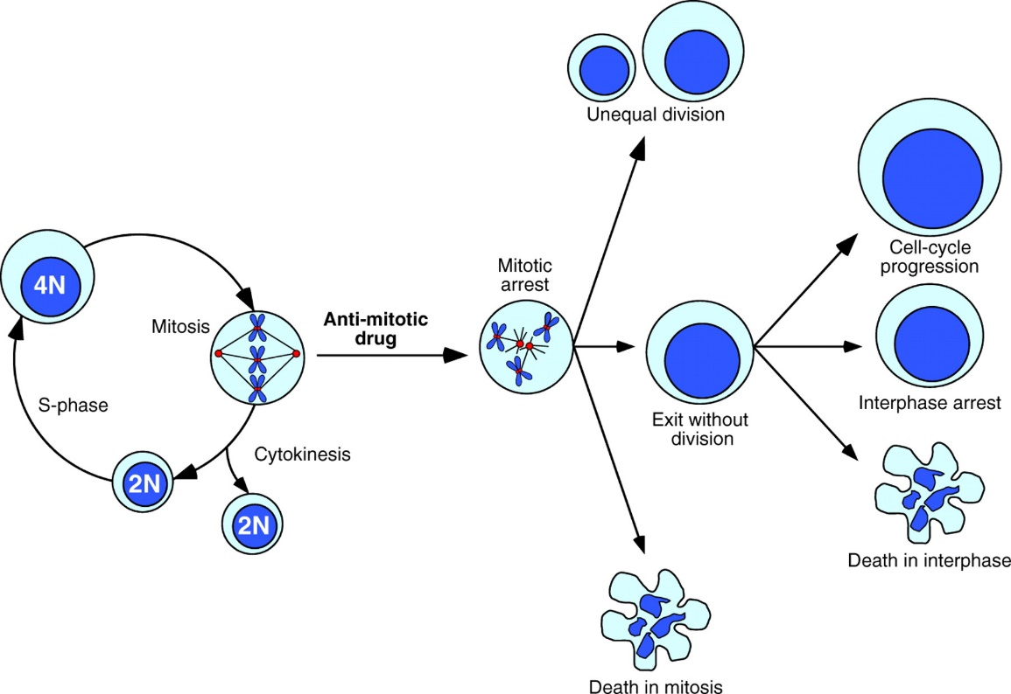
Taxanes
Isolated from bark of pacific yew tree
Prevents tubulin from forming into microtubules, leading to mitotic arrest
Dec 1992 : FDA approval for Ovarian Cancer. 1994 approval for breast cancer.
Best selling anti-cancer drug in history!
Now used in a range of solid tumour types Breast, Prostate, NSCLC, Stomach, and Head & Neck cancers
Lecture 3 | Intro to Chemo & Biologicals

Slide 15
Principles of cytotoxic therapy
Lecture 3 | Intro to Chemo & Biologicals

Slide 16
What do we mean by…
Cytocidal = ?
Cytostatic = ?
Lecture 3 | Intro to Chemo & Biologicals

Slide 17
Important nomenclature
Cytocidal = agent that kills tumour cells, usually during replication. It leads to direct reduction in the number of clonogens in a tumour. Most chemotherapy agents are cytocidal.
Cytostatic = agent that prevents growth of tumour, usually by inhibition of a growth signal or disruption of blood supply. Cell kill is secondary to these mechanisms. Many biological therapies are cytostatic.
Lecture 3 | Intro to Chemo & Biologicals

Slide 18
Sensitivity and tumour proliferation
Tumours that grow rapidly are most likely to respond to chemotherapy. Can you think of examples of tumours that fit each category of chemotherapy response?
High : ?
Intermediate : ?
Low : ?
Lecture 3 | Intro to Chemo & Biologicals

Slide 19
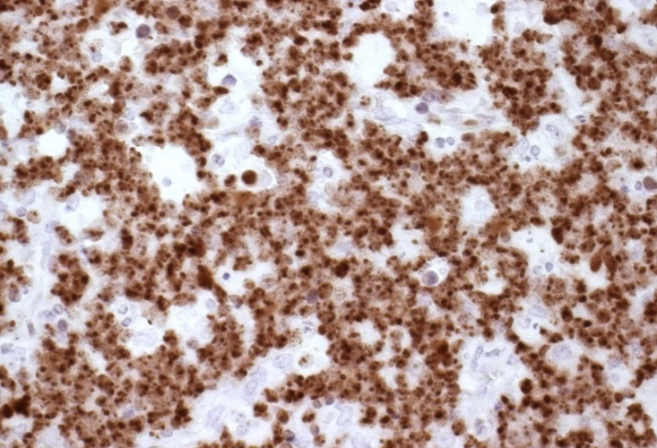
Sensitivity and tumour proliferation
As one would expect, the rate of cell division defines sensitivity to cytotoxics
High : Lymphoma. Leukaemia. SCLC. Testis
Intermediate : Breast. Colorectal. NSCLC
Low : HNSCC. Prostate. Stomach. Pancreas. Glioma.
Non cycling cells should in theory be resistant to most cytotoxic therapy
May want to expose slow growing tumours to chemotherapy over a longer period of time to catch for cells as they leave G0 (e.g. infusional 5FU chemotherapy).
Mib-1 antibody staining of proliferating (i.e. non G0) cells in Burkitts lymphoma. Over 90% of the tumour cells are actively proliferating.
Burkitts Lymphoma is exquisitely sensitive to chemo. We have to be careful giving the chemo for fear of tumour lysis syndrome, causing hyperuricaemia and renal failure!
Lecture 3 | Intro to Chemo & Biologicals

Slide 20
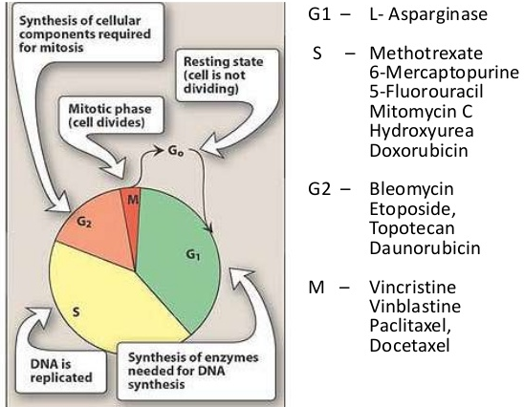
Cytotoxic therapy and the cell cycle
Different cytotoxic agents work at different points in the cell cycle
Combining drugs that act at different points in the cell cycle can lead to synergistic effects
Cell cycle independent:
Alkylating agents
Platinum
Lecture 3 | Intro to Chemo & Biologicals

Slide 21
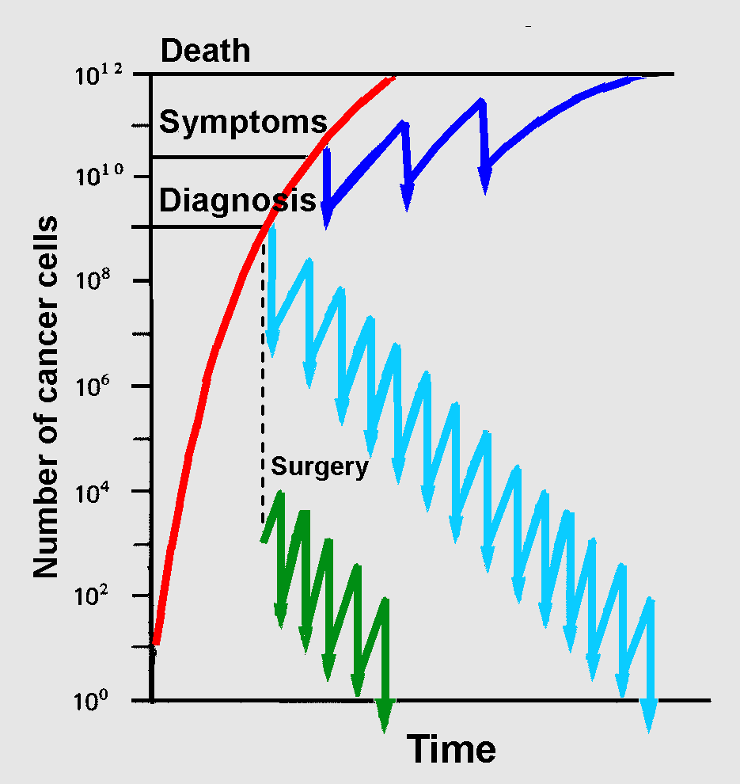
Cytotoxics and fractional cell kill
Cell kill follows first order kinetics, so a constant fraction of cells are killed by a certain dose of drug.
Repeated doses of chemo needed to achieve tumour control.
Palliative therapy. Chemo does not sterilise tumour, but slows rate of tumour growth so as to cause less symptoms, and prolong survival
Curative primary therapy. Give enough doses of chemotherapy that cumulative cell kill brings number of tumour clonogens near to zero
Adjuvant therapy. Surgeon has removed most of the tumour clonogens. Less doses needed to bring tumour clonogens down to zero
Lecture 3 | Intro to Chemo & Biologicals

Slide 22
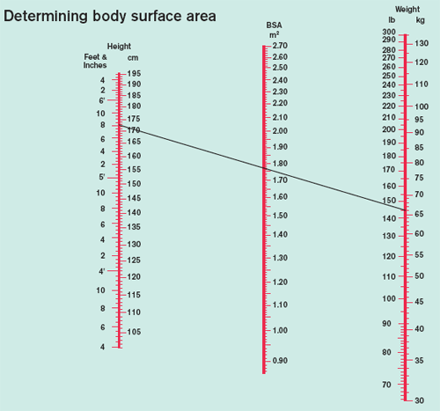
Chemotherapy dosing
Determine lethal concentration in animal model (LC50)
First into Man studies will start at some small percentage of LC50 and gradually increase dose until you get to maximum tolerated dose (MTD)
Most chemotherapy is dosed by body surface area, as this is a good surrogate for drug clearance
Some biologicals dosed by body weight
Carboplatin dosed according to GFR (area under creatinine clearance curve)
Lecture 3 | Intro to Chemo & Biologicals

Slide 23
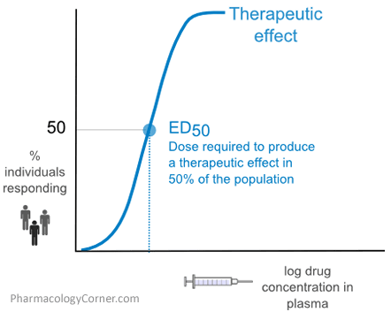
Chemotherapy scheduling
Most standard chemo given on a 3 weekly cycle, because bone marrow takes 3 weeks to recover
Some agents e.g. Procarbazine cause delayed bone marrow suppression so given on 6 weekly cycle
If operating in steep region of dose response curve, may with to increase dose to enhance effect.
Can increase dose a little (dose intensity) or decrease interval between doses (dose density)
Accelerated chemo is given more frequently to increase dose density, but often requires co-administration of supporting therapies (GCSF, antibiotics) to prevent bone marrow suppression & neutropaenic sepsis
High dose chemotherapy is giving doses beyond MTD to deliberately ablate marrow, which is then rescued with stem-cell ransplantation (bone marrow transplants)
Briefly, high dose chemotherapy was used for adjuvant treatment of high risk breast cancer. Women died for what was turned out to be sham evidence (Dr. Bezwoda scandal)
Lecture 3 | Intro to Chemo & Biologicals

Slide 24
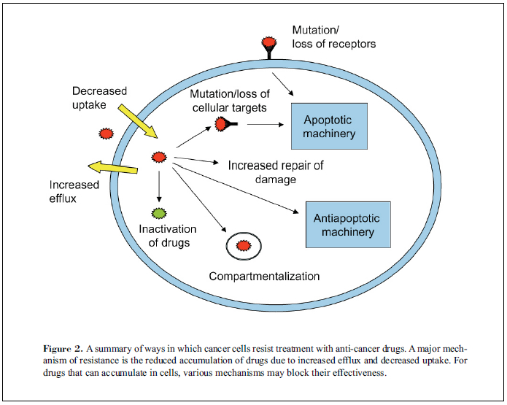
Chemotherapy resistance
Primary resistance (no response ab initio)
Acquired resistance. Adapation / mutation.
Enhance drug efflux out of cell (P-glycoprotein transporters)
Multidrug resistance protein
Compartmentalisation / reduced uptake of agent into nucleus
Upregulate the target enzyme / pathway
Rapid repair of DNA lesions
Abrogation of apoptosis pathway
Combination chemo and sequenced chemo help overcome resistance
Lecture 3 | Intro to Chemo & Biologicals

Slide 25
Toxicity of chemotherapy
Nausea & vomiting : triggered by area postrema near 4th ventricle. Its blood vessels do not contain tight junctions, allowing it to ‘sample’ what is circulating in blood stream
Control of emesis revolutionised by availability of 5HT3 antagonists (Ondansetron) in 1991
Aprepitant (NK1 receptor antagonist) used as add in to Ondansetron in most severe cases of CINV
Highly emetogenic regimens (Use 5HT3 antagonists)
Cisplatin, Dacarbazine, Streptozocin
ABVD, AC, BEP
Moderately emetogenic agents
Methotrexate, Carboplatin, Doxorubicin, Docetaxel, Paclitaxel, Etoposide, Ifosfamide
CHOP & R-CHOP
Mildly emetogenic agents
Capecitebine, Temozolomide, Vincristine, Bleomycin, Fludarabine, hydroxyurea
Lecture 3 | Intro to Chemo & Biologicals

Slide 26
Acute Toxicity
Dominated by rapidly proliferating normal tissue cells
Skin & Mucosa : Mucositis | Alopecia | Extravasation of vesicant agents
Bone Marrow : Anaemia | Neutropaenia | Thrombocytopaenia
Gastrointestinal : diarrhoea | constipation (usually from antiemetics) | Typhlitis (neutropaenic enteritis)
Neurological : encephalopathy (ifosfamide)
Systemic allergic response : Taxanes
Tumour lysis syndrome : Hyperkalaemia | Hyperuricaemia | Metabolic acidosis | Renal Failure (pre-hydration and allopurinol given before chemo)
Lecture 3 | Intro to Chemo & Biologicals

Slide 27
Late Toxicity
Tissue specific effects–
Cardiac : Anthacyclines (LVEF), 5FU (coronary arteries)
Renal : Cisplatin, Carboplatin, Carmustine, High dose Methotrexate
Hepatic : lots!!! (esp Alkylating agents)
Lung fibrosis : Bleomycin
Nerve toxicity & Deafness : Vincristine, Oxaliplatin, Cisplatin
Effect on fertility : esp Busulphan, Cisplatin, Carboplatin, Chlorambucil, Cyclophosphamide, Doxorubicin, Ifosfamide, Procarbazine, Temozolomide
Carcinogenicity and teratogenicity
Lecture 3 | Intro to Chemo & Biologicals

Slide 28
Introduction to biological therapies
Lecture 3 | Intro to Chemo & Biologicals

Slide 29
Classes of biological therapies
Monoclonal antibody therapies (All end in ‘ab’)
Parenteral administration of humanised monoclonal antibodies directed against growth factor receptors
Immune activation through biding to CTLA-4 and activation of cytotoxic T lymphocytes
Small molecule inhibitors of tyrosine kinases (all end in ‘ib’)
Block action of constitutively active, or overexpressed growth factor receptor / signalling complexes or other key druggable targets
Target Tyrosine kinases, MTOR, PI3 Kinases, Histone Deacetylases
Non specific immune activation (Interferons, Interleukins)
Specific vaccines
Antigen vaccines, dendritic cell vaccines, DNA vaccines, etc
Big area of development – we will review a few key examples you might see in the clinic
Lecture 3 | Intro to Chemo & Biologicals

Slide 30
Biological therapies – Fab 5
Avastin (Bevacizumab)
Herceptin (Trastuzumab)
Gefitinib
Sunitinib
Imatinib
Lecture 3 | Intro to Chemo & Biologicals

Slide 31
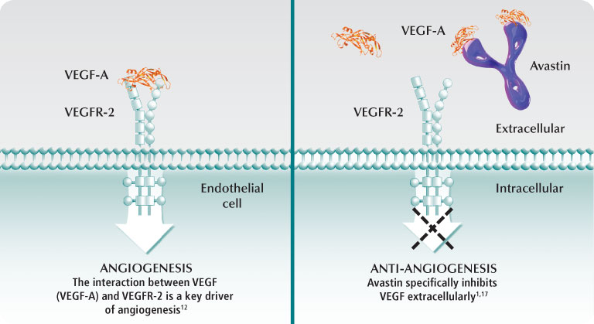
Avastin (Bevacizumab)
Monoclonal antibody directed against VEGF-A. Prevents binding to VEGFR-2 and thus blocks downstream angiogenic signals
Generally very well tolerated
Problems with impaired wound healing, hypertension, proteinuria and renal injury.
Lecture 3 | Intro to Chemo & Biologicals

Slide 32
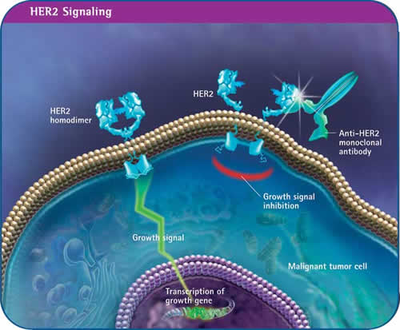
Herceptin (Trastuzumab)
Monoclonal antibody directed against HER2/neu receptor, prevents binding of EGF, dimerisation and downstream signalling
Well tolerated generally, though can cause myocardial toxicity (quite rare), especially if the patient has had prior anthracycline treatment.
Lecture 3 | Intro to Chemo & Biologicals

Slide 33
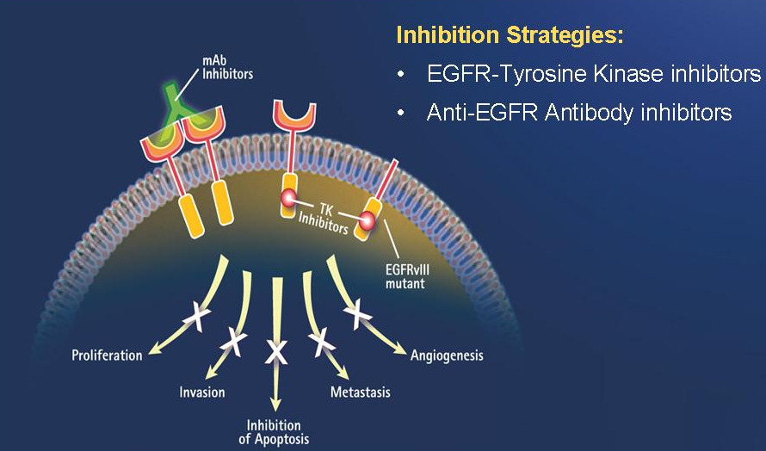
Iressa (Gefitinib)
Inhibits the tyrosine kinase domain of EGFR. Mutation in EGFR pathway greatly enhances apoptotic response to gefitinib
Now use pre-treatment EGFR testing which is strongly predictive of treatment response.
Lecture 3 | Intro to Chemo & Biologicals

Slide 34
Glivec (Imatinib)
A great example of a lock and key targeted therapy
Tyrosine kinase inhibitor specifically targeting BCR-ABL fusion protein which is constitutively active. Found in Philadelphia chromosome positive CML
Also targets cKIT which is overexpressed in gastrointestinal stromal tumours
Lecture 3 | Intro to Chemo & Biologicals

Slide 35
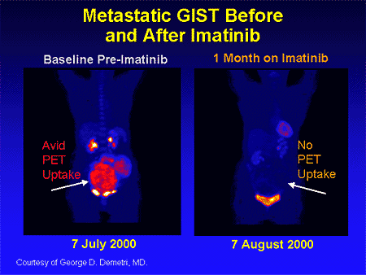
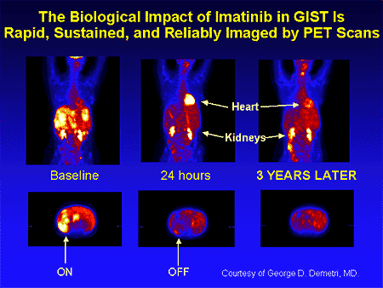
Imatinib responses
Care with response assessment in GIST. Tumours may not reduce in size on a CT
PET imaging tells the true story …
Lecture 3 | Intro to Chemo & Biologicals

Slide 36
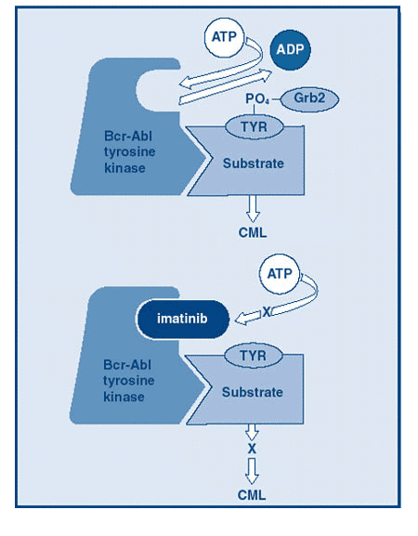
Resistance to biological therapies
Despite lock and key nature of TKI’s resistance dose develop
Tyrosine kinase will often mutate at the ATP binding area, causing steric hindrance and preventing TKI from binding
All it takes is an extra methionine residue (T790M) sticking out in this space…
…and the TKI can’t fit the ATP binding site any more!
Lecture 3 | Intro to Chemo & Biologicals

Slide 37
Conclusion
Light touch review of a very big field (£0.8 Billion = NHS annual chemo spend)
Moving from single agent broad action cytotoxic therapies, to combination cytotoxic therapies and biologically targeted therapies improves the therapeutic index of our treatment
Important to consider possible side effects of chemotherapy up front
In spite of increasing availability of targeted therapies, resistance to chemotherapy is will eventually occur
Lecture 3 | Intro to Chemo & Biologicals

