Slide 1

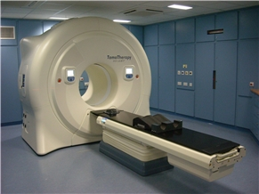
Medical Student Training in Oncology
Lecture 4
Principles & practice of radiation therapy

Slide 2
Overview of seminar
  Indications for RT
  Types of RT
  Principles of RT
  Side effects of RT
  RT treatment process
Lecture 4 | Radiotherapy

Slide 3
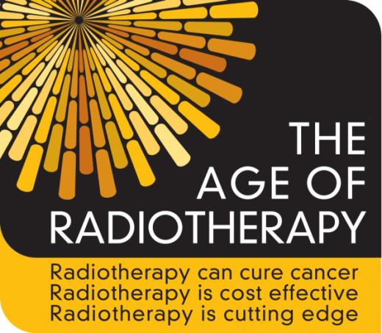
3 C’s of Radiotherapy
Radiotherapy
Can cure Cancer
Is Cost-effective
Is Cutting edge
Lecture 4 | Radiotherapy
Notes:
RT has received a pretty bad press in the past, but I would like to start with a key message…

Slide 4
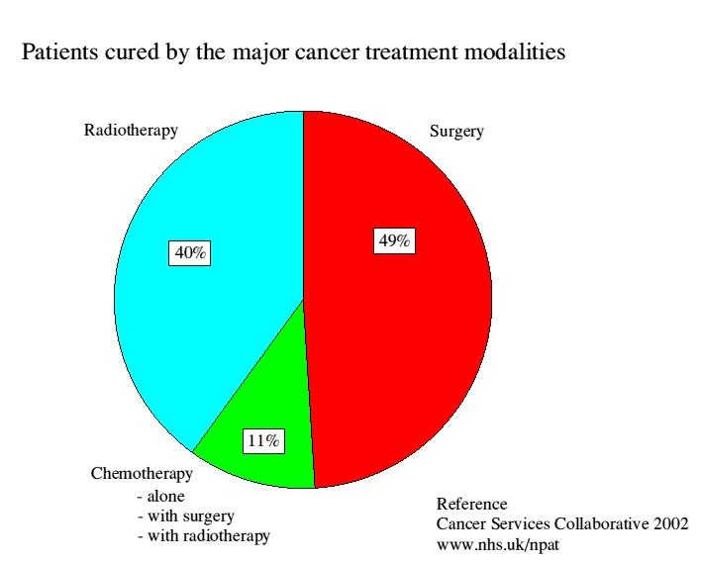
RT can cure cancer
~ 40% of people will develop cancer
50% will require RT
Of which 60% is curative
Lecture 4 | Radiotherapy
Notes:
So let’s look at this in more detail. RT can cure cancer…

Slide 5
RT is cost effective
Cost of adjuvant treatment:
Breast chemotherapy ~ £5,000
Breast RT ~ £2,500
Lecture 4 | Radiotherapy
Notes:
Breast RT is cost-effective…. It is around half the cost of chemotherapy

Slide 6
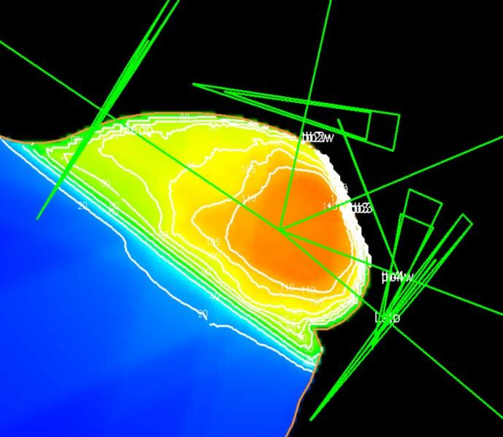
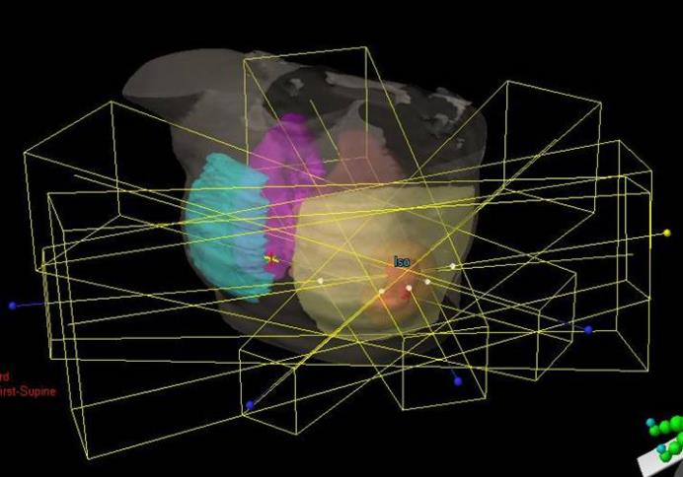
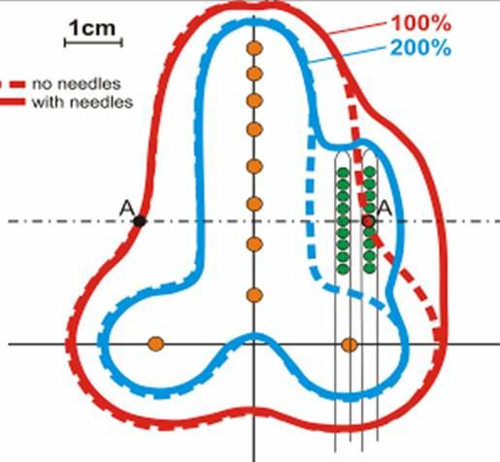
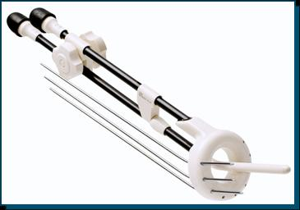
RT is cutting edge
IMPORT HIGH
2.4Gy
2.7Gy
3.2Gy
15 fractions
Lecture 4 | Radiotherapy
Notes:
Breast RT is cutting edge. This slide gives examples of my 2 clinical areas of interest: breast & gynae RT. The top pictures show breast IMRT, & the bottom shows cervix IGBT & I will discuss these complex techniques in more detail later.

Slide 7
Indications for RT
Lecture 4 | Radiotherapy

Slide 8
Radical RT
Primary curative treatment
  Squamous cell carcinomas
    Skin
    Cervix
    Head + neck
    Lung
    Anus
  Lymphoma
  Prostate
  Concomitant chemotherapy
Lecture 4 | Radiotherapy

Slide 9
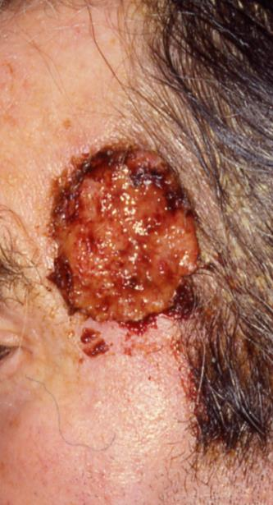
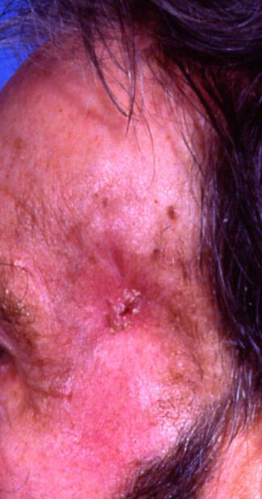
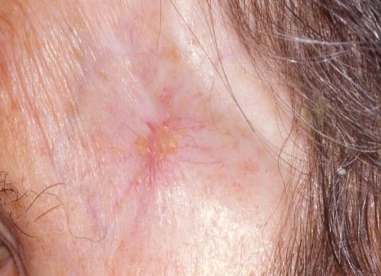
Radical RT
Pre-RT
6 weeks later
9 months later
Lecture 4 | Radiotherapy

Slide 10
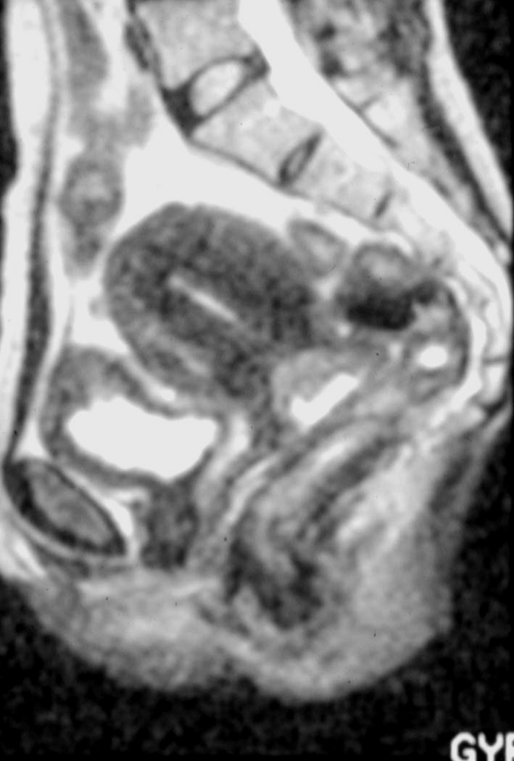
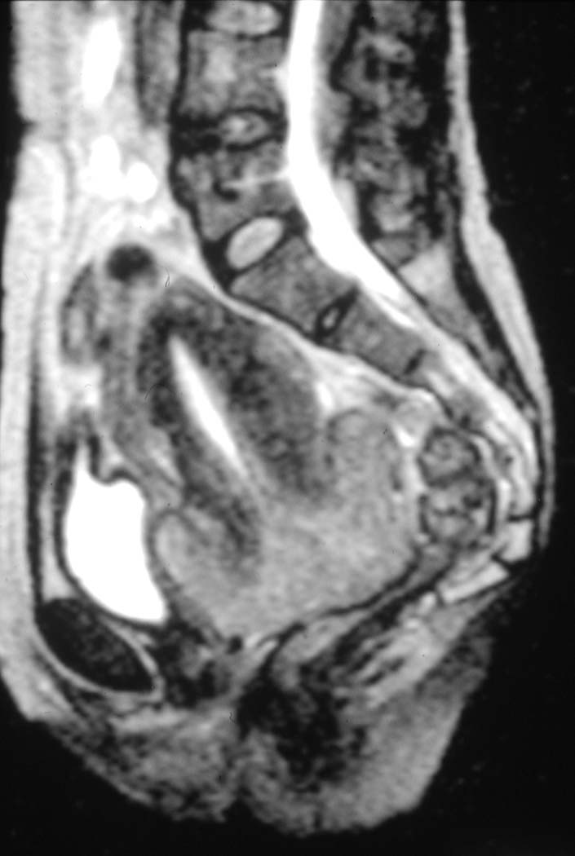
Radical RT
Start EBRT
End EBRT
Lecture 4 | Radiotherapy

Slide 11
Adjuvant RT
Supplement to primary curative treatment
  Reduce local recurrence
  Improve survival
Sites
  Localised, critical structure tolerance
    Breast
    Rectum
    Endometrium
    Sarcoma
Lecture 4 | Radiotherapy

Slide 12
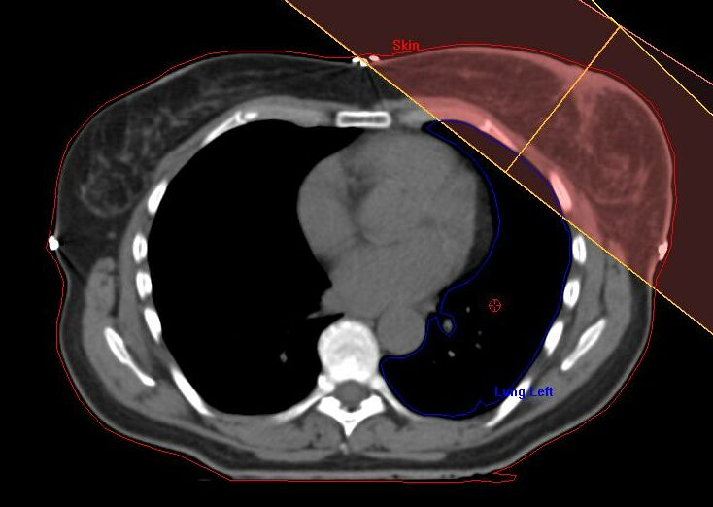
Breast RT
Lecture 4 | Radiotherapy

Slide 13
Palliative RT
Local
  Bone pain
  Pressure
    Nerve/cord compression
    Soft tissue
  Bleeding
NOT
  Discharge
  SOB
  General e.g. weight loss
Lecture 4 | Radiotherapy

Slide 14
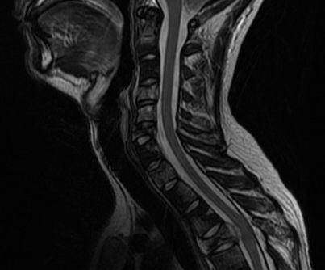
Palliative RT
Lecture 4 | Radiotherapy

Slide 15
Types of radiotherapy
Lecture 4 | Radiotherapy

Slide 16
Types of RT
  External beam (teletherapy)
  Radioactive implants (brachytherapy)
  Radioactive isotopes
Lecture 4 | Radiotherapy

Slide 17
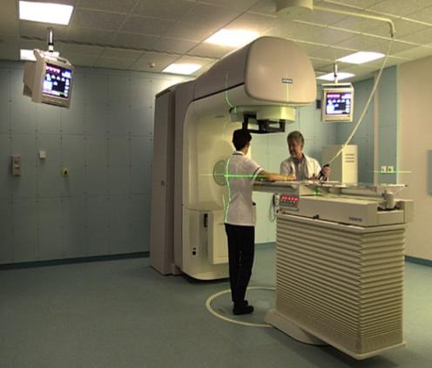
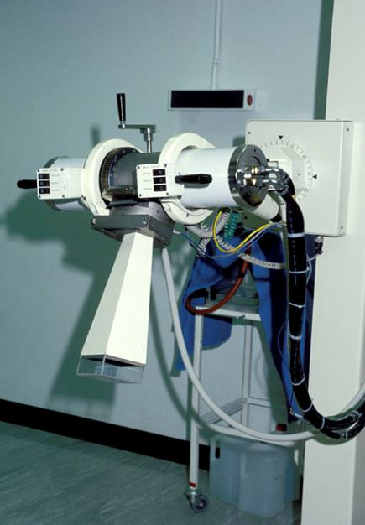
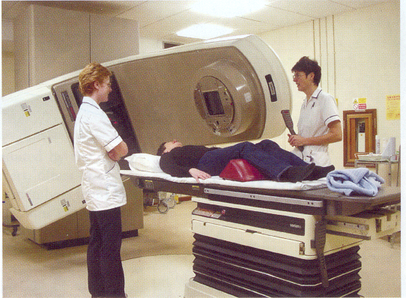
Machines
Linear accelerator
Superficial/orthovoltage
Lecture 4 | Radiotherapy

Slide 18
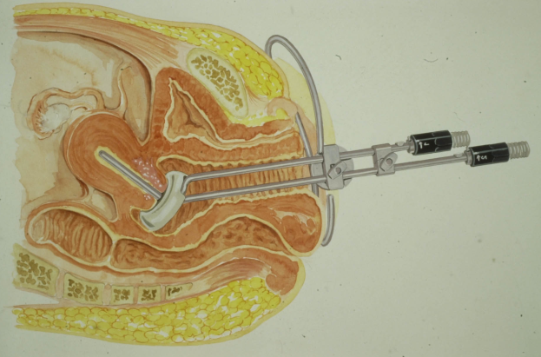
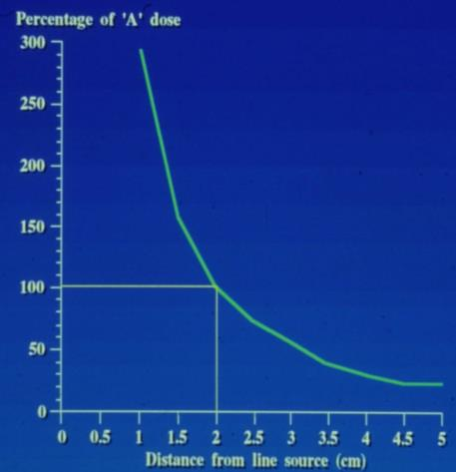
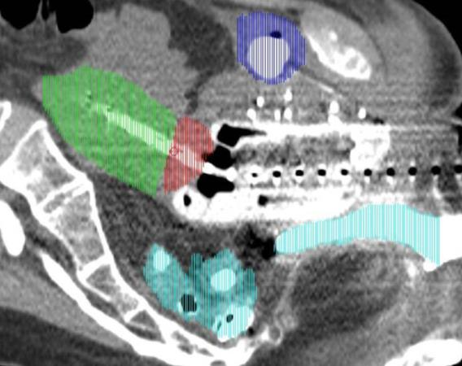
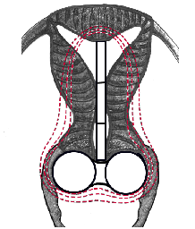
Brachytherapy
Inverse square law
Dose ∝ 1/d²
Lecture 4 | Radiotherapy

Slide 19
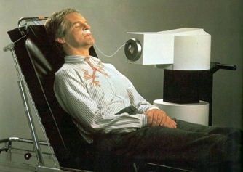
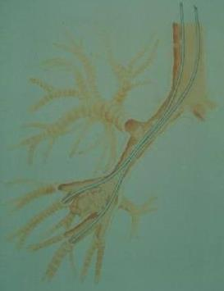
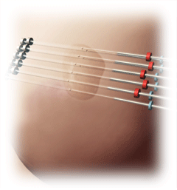
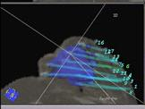
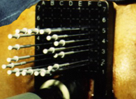
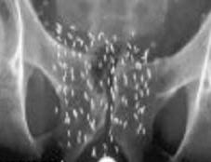
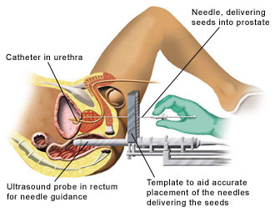
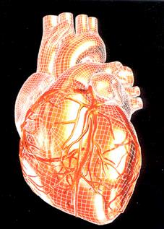
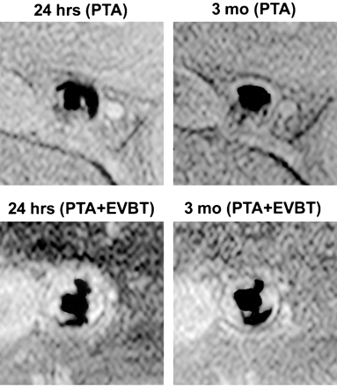
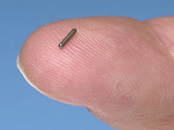
Brachytherapy
Lecture 4 | Radiotherapy

Slide 20
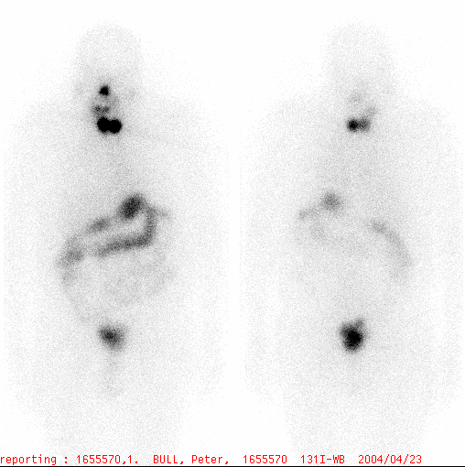
Isotope therapy
Lecture 4 | Radiotherapy

Slide 21
Principles of RT
Lecture 4 | Radiotherapy

Slide 22
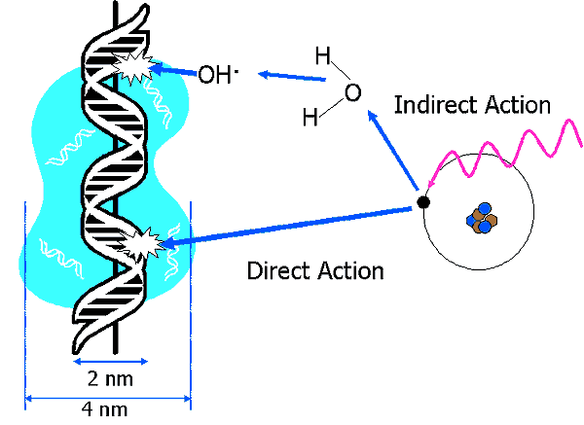
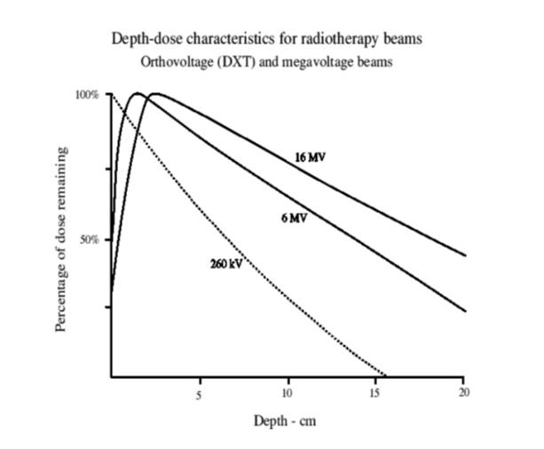
Physical basis for radiotherapy
High energy x-rays interact with matter to produce high energy electrons
  Direct effect – direct interaction of electron with DNA to produce DSBs and SSBs
  Indirect effect – electron interacts with a water molecule close to DNA. The water molecule is split into reactive H· and OH · radicals and these induce double and single stranded breaks
Without matter to interact with, an x-ray won’t deposit dose. This is the build-up effect
Higher energy x-rays pass further through the body before interacting with tissue, hence depositing dose deeper into tissues
Lecture 4 | Radiotherapy

Slide 23
Dose
  Radiation dose = absorbed energy
    SI unit = gray (Gy) = joule per kilogram
  Radical (eradicate macroscopic disease)
    > 60 Gy
  Adjuvant (eradicate microscopic disease)
    ~ 50 Gy
  Palliative (no tumour eradication)
    30 - 40 Gy
Nomenclature
Gray= unit of absorbed dose in tissue
Sievert = unit of dose multiplied by ‘quality factor’ representing biological effect of that dose
Used in radiation protection
For X-rays, 1Sv = 1Gy
1Gy : Thermal energy in a cup of coffee
Lecture 4 | Radiotherapy

Slide 24
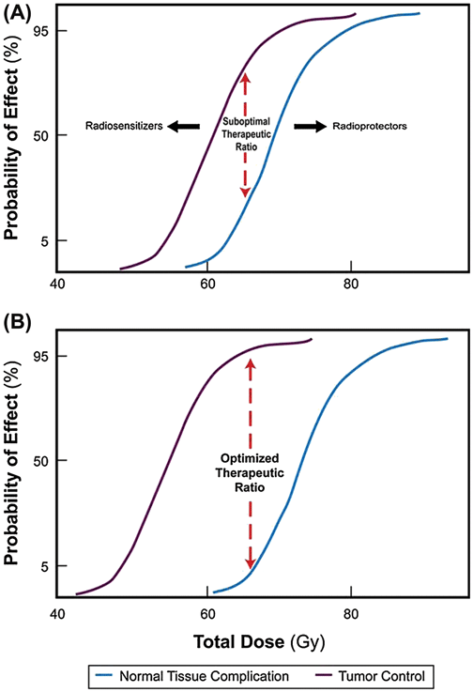
RT Dose & therapeutic index
Best chance of cure, with least normal tissue side effects - separate these two curves as much as possible:
  Conform dose to tumour & away from normal tissues (Radiotherapy Physics)
  Break up treatment into fractions to allow normal tissue to repair (Radiation biology)
  Enhance tumour kill, or protect health cells, by combining drugs with RT (Cell biology)
Lecture 4 | Radiotherapy

Slide 25
Acute toxicity
Starts ~2 weeks into treatment
Resolves ~2-4 weeks after completion
Affects fast proliferating tissues “itis”, e.g.
  Dermatitis
  Enteritis
Lecture 4 | Radiotherapy

Slide 26
Late toxicity
Begins 6 months to 2 years after RT
Fibrosis
Vascular damage
  Small vessel dilatation
  Small vessel constriction
Lecture 4 | Radiotherapy
Notes:
My very simple approach.. Can be applied to any part of the body

Slide 27
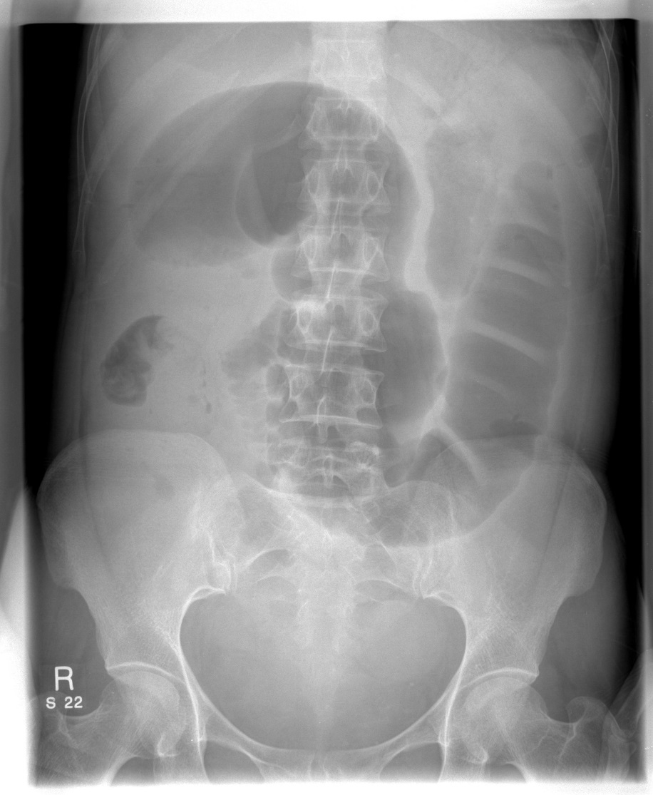
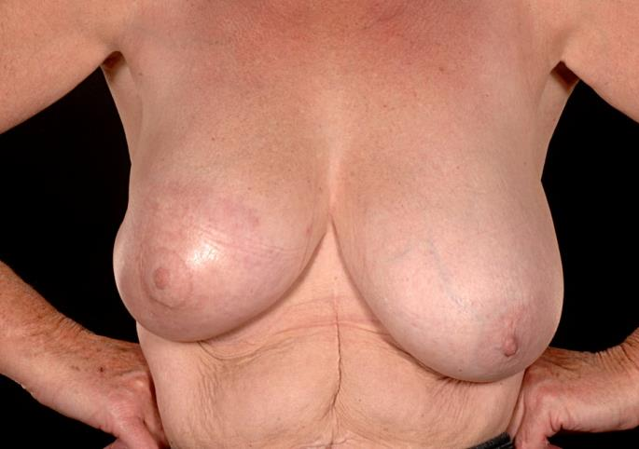
Late toxicity: Fibrosis
Lecture 4 | Radiotherapy
Notes:
Fibrosis in breast – breast smaller and retracted. Fibrosis in bowel – strictures: crampy pain, can cause obstruction..

Slide 28
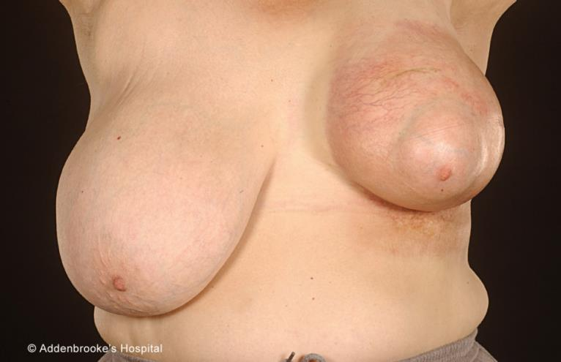
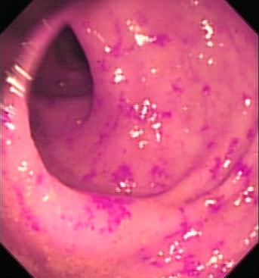
Late toxicity: Vascular damage - small vessel dilatation
Lecture 4 | Radiotherapy
Notes:
Unsightly blood vessels in the breast skin – Telangiectasia. Same can happen in the bowel - bleeding

Slide 29
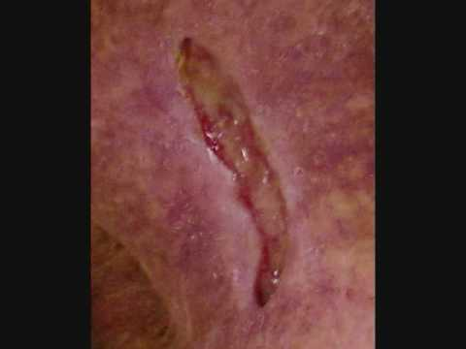
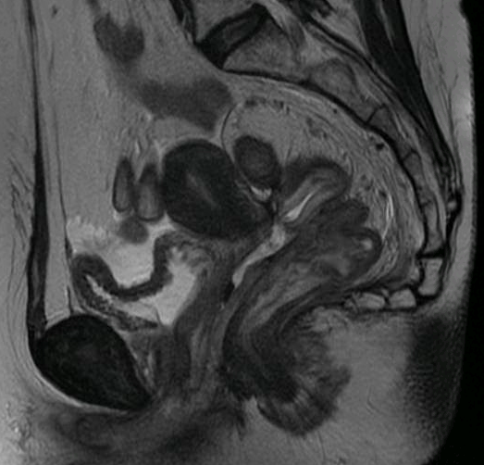
Late toxicity: Vascular damage - small vessel constriction
Lecture 4 | Radiotherapy
Notes:
Ischaemia & necrosis – unhealing ulcers in skin (very uncommon in breast – lower dose as adjuvant Rx). Need high curative doses for cervix cancer (in combination with chemo) – may cause ischaemia, necrosis and fistulae as shown here.

Slide 30
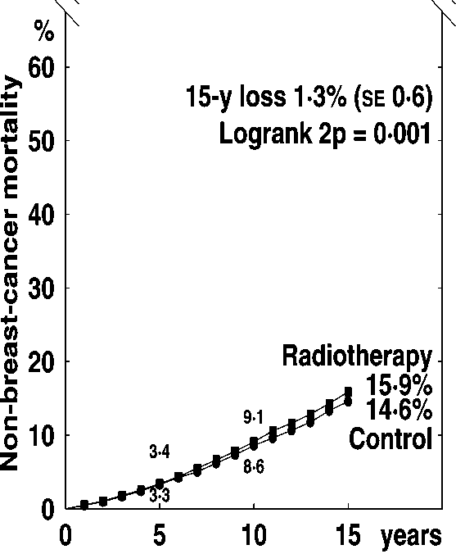
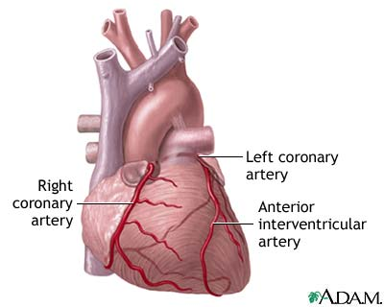
Side effects of RT are rare, but can be serious – e.g. cardiac
Early Breast Cancer Trialists’ Collaborative Group, Lancet, 2005
Lecture 4 | Radiotherapy
Notes:
Cardiac toxicity is a rare but important side effect of breast RT, especially as so many patients are now cured form breast cancer and therefore can potentially develop cardiac side effects many years after RT. This graph from the EBCTCG shows that at 15 years form RT, the non-breast cancer mortality is around 1% higher in the RT group. (old data, but today still have have to be very careful – cardiotoxic chemo), Mention LAD

Slide 31
Optimising therapeutic ratio
  Conform dose to tumour & away from normal tissues
  Break up treatment into fractions to allow normal tissue to repair
  Enhance tumour kill, or protect health cells, by combining drugs with RT
Lecture 4 | Radiotherapy

Slide 32
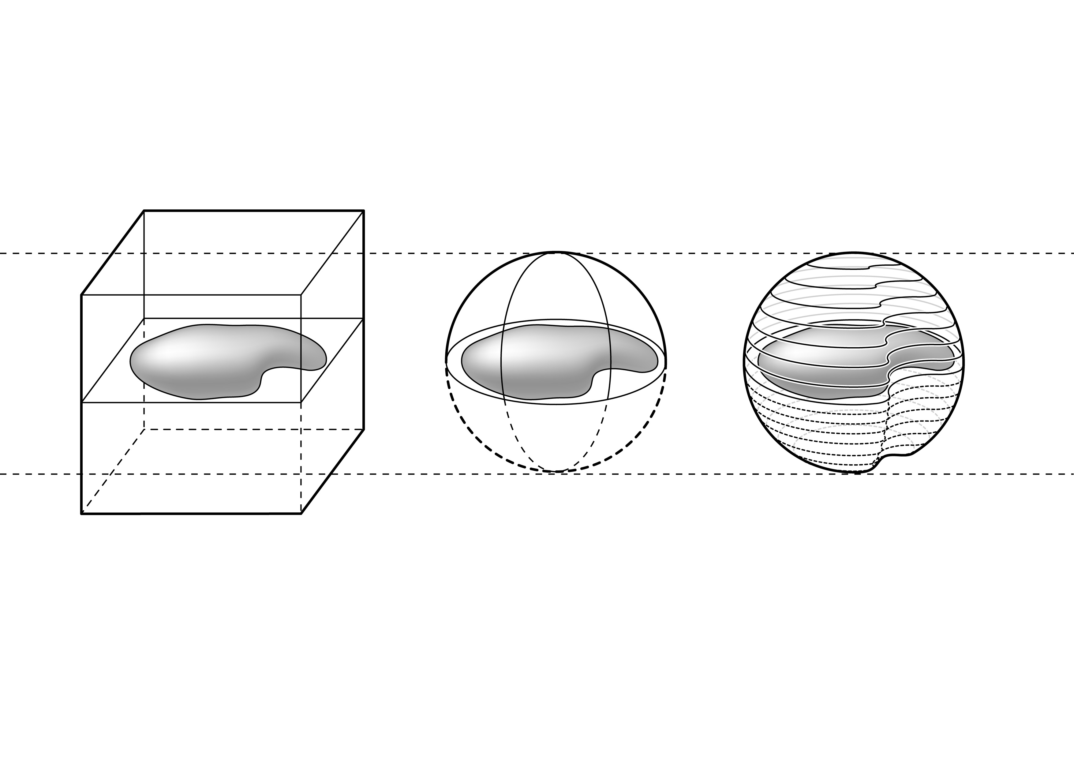
Conforming dose: smaller volumes
Conventional ‘square’ plan
3D conformal plan
IMRT plan
Lecture 4 | Radiotherapy
Notes:
IMRT – treat concave volumes, particularly important if RT target is close to a critical normal structure

Slide 33
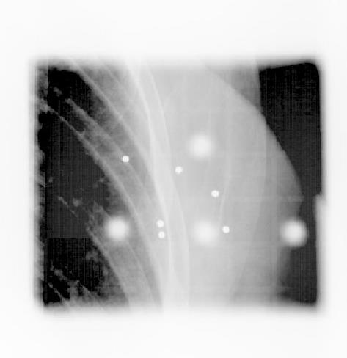
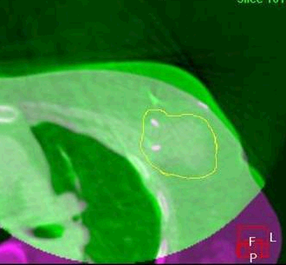
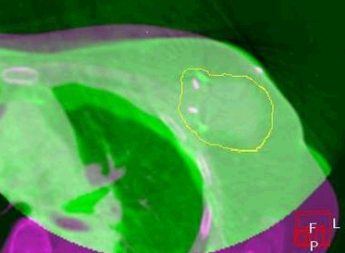
Conforming the dose: better targeting
Image-guided radiotherapy (IGRT)
Lecture 4 | Radiotherapy
Notes:
All very well, planning all these fancy dose distributions with IMRT: you have to be sure that you deliver it exactly where is it required – IGRT…By using IGRT, we can safely reduce the margins for uncertainty we apply around our RT targets – means smaller vol of normal tissue irradiated.

Slide 34

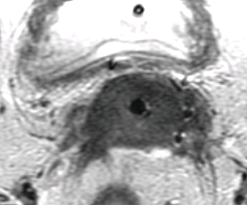
Image-guided brachytherapy (IGBT)
Benefit: 20% increase local control AND 10% decrease in late toxicity
Lecture 4 | Radiotherapy
Notes:
Give EBRT to pelvis with chemo. Then have to give a very high boost dose to cervix. Do this with BT – applicator inside patient – deliver RT source. Vienna – developed use of MR-guided BT. See the tumour accurately – boost with interstitial needles…Benefit ….This is being introduced around the country in the UK, but not all not universal.

Slide 35
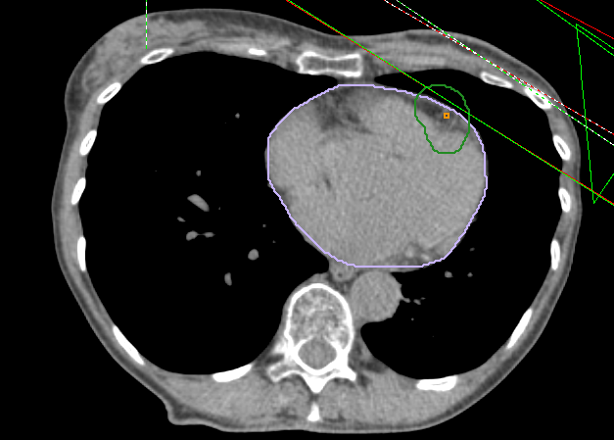
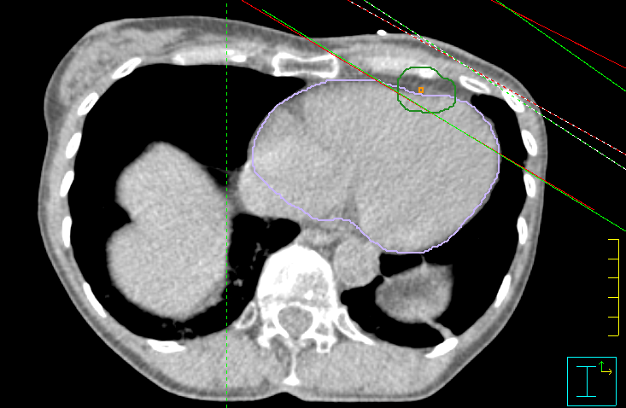

Avoiding critical structures
ABC_DIBH
Free breathing
v_DIBH
Lecture 4 | Radiotherapy

Slide 36
Optimising therapeutic ratio
  Conform dose to tumour & away from normal tissues
  Break up treatment into fractions to allow normal tissue to repair
  Enhance tumour kill, or protect health cells, by combining drugs with RT
Lecture 4 | Radiotherapy

Slide 37

RT Time and fractionation
Breaking treatment up into small daily treatments, and we see the following cell killing effect in the tumour cells (cell loss), depending on the speed with which they regrow (repopulate) between treatments
In contrast, normal tissues won’t regrow much at all , but they will repair most of the DNA damage between treatments
This is why most radiotherapy is given as a 6-7 week course of radiotherapy treatment fractions
Lecture 4 | Radiotherapy

Slide 38
Optimising therapeutic ratio
  Conform dose to tumour & away from normal tissues
  Break up treatment into fractions to allow normal tissue to repair
  Enhance tumour kill, or protect health cells, by combining drugs with RT
Lecture 4 | Radiotherapy

Slide 39
Chemo-radiation for cervix cancer
Addition of chemotherapy to radiotherapy significantly improves 5-year survival
Metaanalysis | Trials | Patients | Increase | HR | p value
2001 (2005) | 24 | 4921 | 10% (7 to 13%) | 0.69 (0.61 to 0.77) | <0.00001
2002 | 8 | 1065 |  | 0.74 (0.64 to 0.86) | 0.00006
2008 | 13 | 3104 | 6% | 0.81 (0.71 to 0.91) | 0.0006
Lecture 4 | Radiotherapy

Slide 40
RT treatment process
Lecture 4 | Radiotherapy

Slide 41






Consultation
Immobilisation, imaging for RT
Target volume delineation
Treatment planning
Treatment delivery
Imaging during treatment
Follow-up / outcome tracking
Lecture 4 | Radiotherapy

Slide 42






Immobilisation shell
Lecture 4 | Radiotherapy

Slide 43

Breast board
Lecture 4 | Radiotherapy

Slide 44

RT Treatment planning workflow
Lecture 4 | Radiotherapy

Slide 45
Summary
RT is a spatially targeted anti-cancer therapy that induces lethal DNA damage into cancer cells
RT is used to achieve local control in tumours with both curative and palliative intent
A range of new RT technologies share the aim of delivering high dose to tumour and low dose to surrounding tissues
Extensive use of imaging to plan and deliver radiotherapy
Acute & late side effects of RT need careful consideration
Lecture 4 | Radiotherapy

Slide 46
Extension work
During your attachment take the opportunity do learn about:
  How a patient is prepared for radiotherapy treatment (Radiographers, Clinical Oncologists)
  Watch an image guided radiotherapy treatment being delivered (LA3/4 radiographers)
  Observe radiotherapy treatment planning (oncologists, dosimetrists)
  Sit in when a patient is being consented for radical radiotherapy (clinic)
  Look out for any interesting radiotherapy treatments being prepared (e.g. brachytherapy, radiosurgery)
Lecture 4 | Radiotherapy | Slide 57

Slide 47



Additional reading
Radiotherapy is mostly a postgraduate speciality, but if you do want to find out more, take a look at:
Walter & Miller’s Textbook of Radiotherapy (7th Ed). A very light read used by our radiographers when they start in radiotherapy. A bit physics based.
External beam therapy by Peter Hoskin. A bit more clinical, but still a very clear book.
http://www.cancerquest.org/radiation-therapy-introduction.html
Geared to American practice, but still useful
Lecture 4 | Radiotherapy | Slide 58

